Slide 1
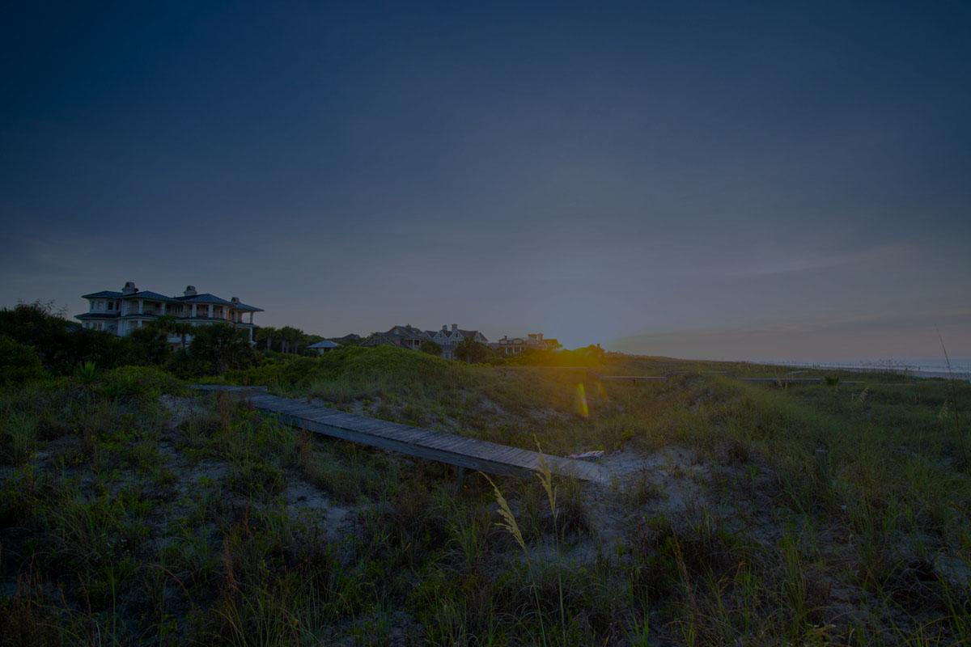
South Street Partners
2024 August Monthly Report

Slide 2
Sitelink Project (final draft)
Justin Winter competitor campaign
(PBL): Account reconstruction
  Lead Generation (60%)
    Search - Real Estate
    Display - CTA-based
    Dynamic - Search/Listing focused
  Consideration (25%)
    Search - General
    Display - Retargeting
  Brand Awareness (15%)
    Search/Display - Lifestyle
    Search - Brand/competitive
Location bid adjustment based on sale History
Broad match test, 1:1 listings reconstruction
(BRP): Bid adjustments for top performing counties
SEM Strategy Topics

Slide 3
All properties:
  CLF, PBL, KIRE, BRP
    3 new blogs written and implemented with schema
Organic
(All Properties)

Slide 4
Programmatic Display Ads - KIRE
Broad Match keyword test - KIRE, CLF, PBL, SEA
Strategic Sitelink test - KIRE, CLF, PBL, SEA
Performance Max Listing Spotlight test - Q4
Digital
Optimization Experiment Summary

Slide 5

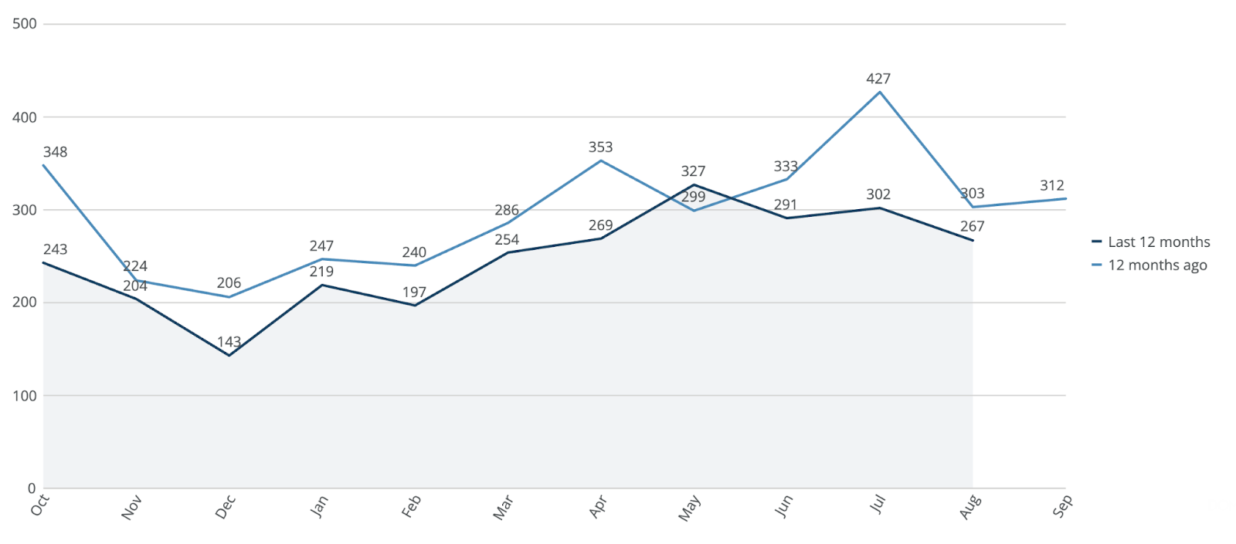
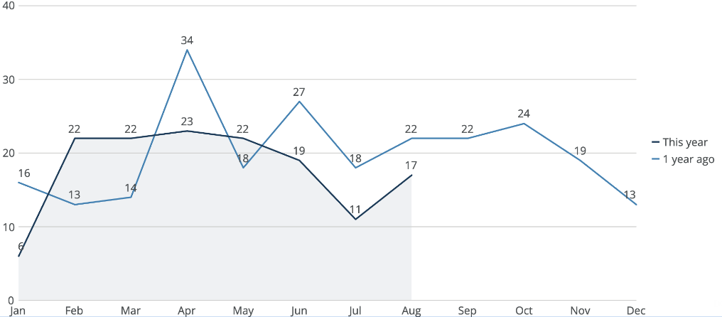
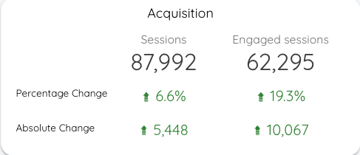
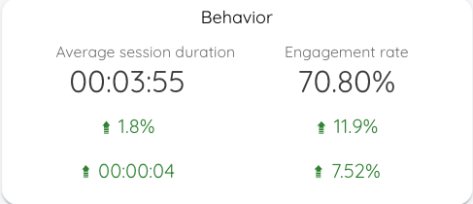
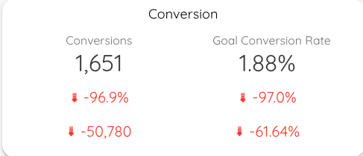


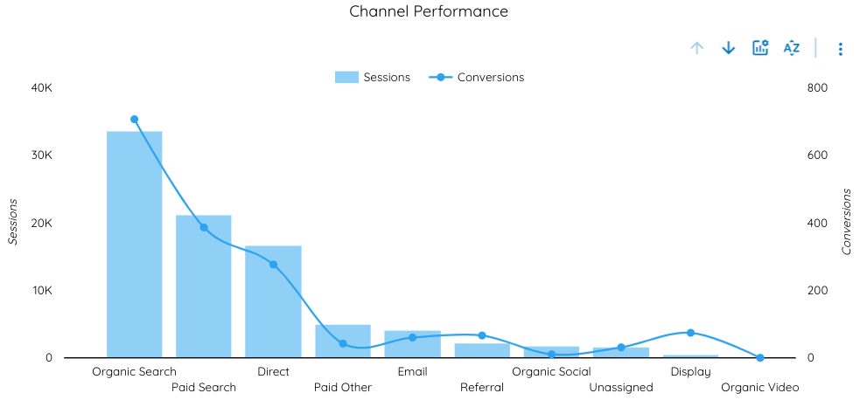
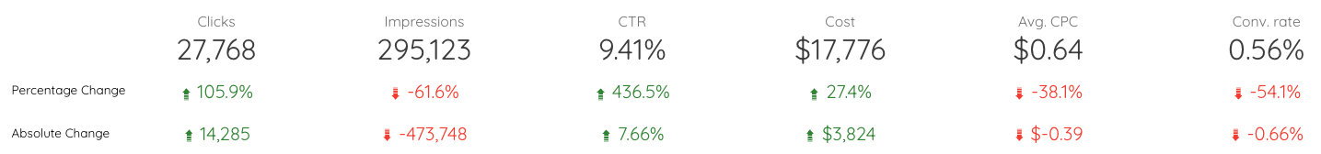
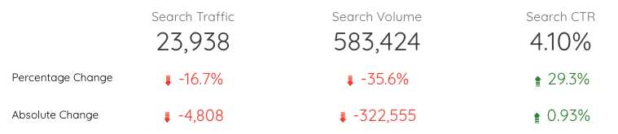

CLF: Summary
Leads
Contracts
August 2024: 267
August 2023: 303
August 2024: 17
August 2023: 22

Slide 6
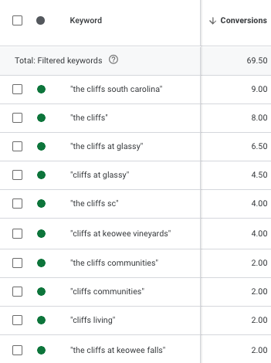
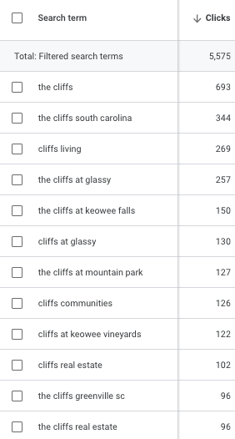
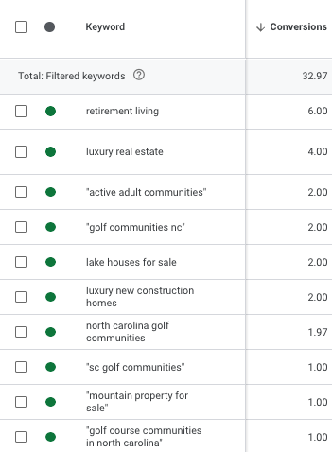
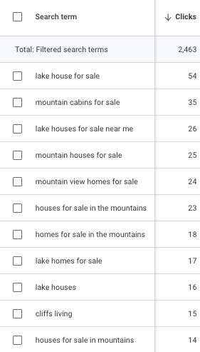
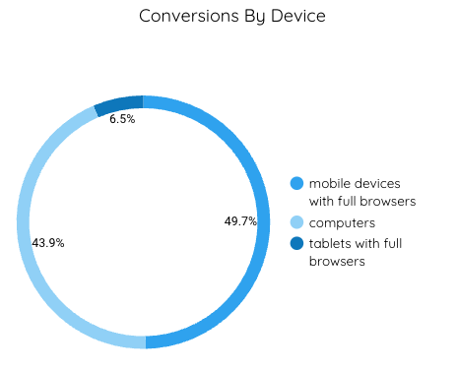
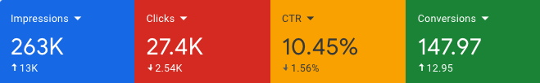
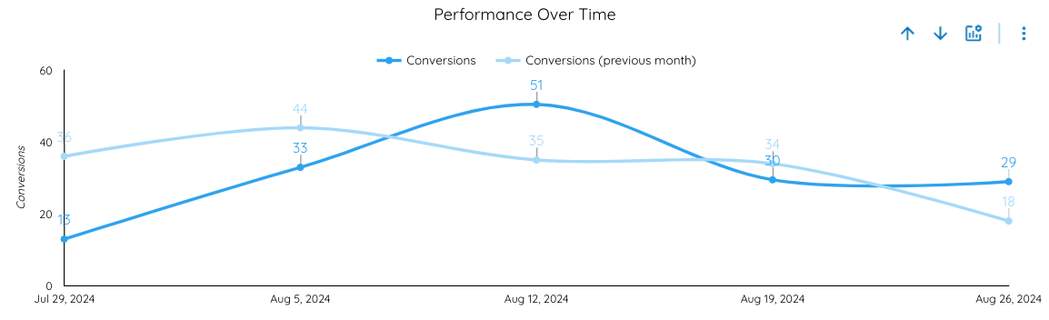
Branded
Non-Branded
CLF: Paid
MoM Comparison
Paid metrics see steady increases MoM. Impressions show notable increases with conversions also showing steady increases. Non-branded keyword ‘retirement living’ saw the highest conversions, but many of the search terms contained mountain or lake related keywords. As we approach the fall season, ad copy will be changed to better reflect what people are searching for in an effort to boost ad relevance and CTR:
Mountain Cabins For Sale
Lake Homes For Sale in SC
Notably, mobile devices saw almost 50% of conversions.

Slide 7
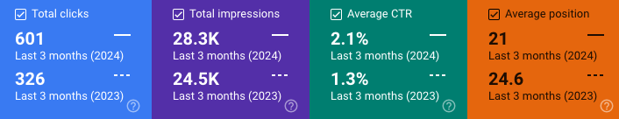
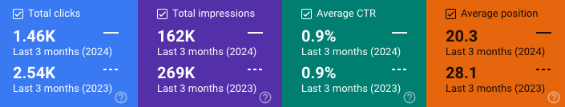
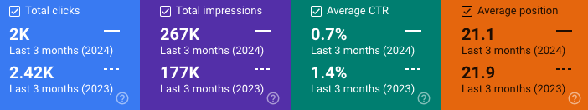
CLF: Organic Users & Traffic
YoY Comparison of Organic traffic
Summary:
Property Listing traffic from organic sources is up significantly in % terms.
Community page and general Real Estate page views are lagging due to decreases in total impressions and CTR, respectively
Listings
Communities
Real Estate

Slide 8
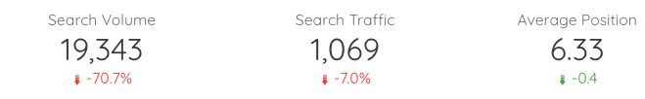
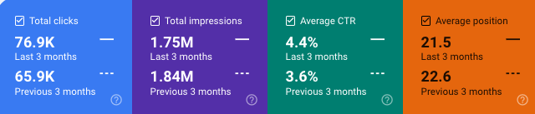
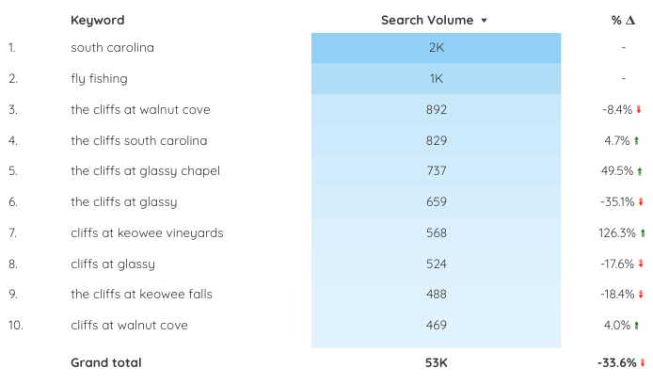
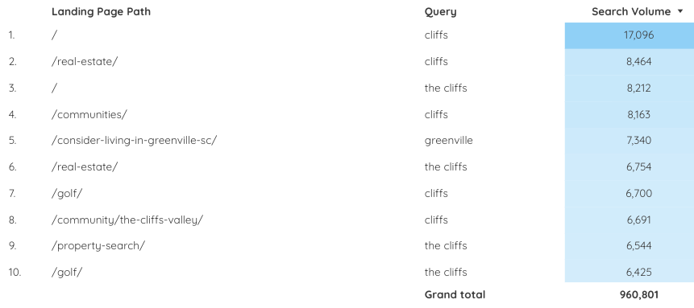
CLF: Organic Users & Traffic
“Blue ridge” related keywords such as “blue ridge mountains” saw a large decrease in both impressions and clicks. Generic keywords saw a large dip in comparison to branded.

Slide 9
CLF: Takeaways
Overall organic search traffic is down, but this seems to be largely driven by declining performance for ancillary search terms (e.g. “blue ridge mountains’)
  All metrics (sessions, engaged sessions, average session duration, engagement rate) show steady increases YoY
  The only metric that has decreased is conversions, which is due to removing property page view conversions
  Overall search traffic for organic is down, however we saw a notable increase in CTR YoY, signaling that users find ad copy engaging
Paid search account maintenance
  Keyword optimizations
    Added negative keywords found from search terms
      [retirement home]
      “Affordable”
      rent
  Changed bid strategy
    Search - Brand and Search - Golf
      Changed from maximize clicks to maximize conversions
  Search - Lifestyle
    Target CPA (cost per acquisition) to $84
Justin Winter competitor campaign
  Competitor research has been done and an experiment brief has been created
  Using what we see found from organic keyword research, we will target the most common keywords that people are searching for when visiting Justin Winter’s website
  We will start with a smaller budget similar to Walnut Cove to determine effectiveness and optimize accordingly
Sitelink project implementation
  Using what we’ve created last month, we will implement the newly created sitelink experiment. Google Ad sitelinks are the 3 to 5 additional links at the bottom of an ad. Roughly ⅔ of all ad clicks are through sitelinks rather than the main ad link, and avg click-through-rate for sitelinks vs ads is 20-40% higher. Each campaign will contain 4-5 sitelinks specific to the campaign that leads to a relevant landing page
Improve ad strength
  Improving ad strength by adding more varied text and image assets to all campaigns. Some of our ads have only “good” or “average” ad strength as seen by Google. By increasing them to “great” or “excellent”, our ad relevance, quality, and effectiveness will increase along with it

Slide 10
CLF: Questions?

Slide 11
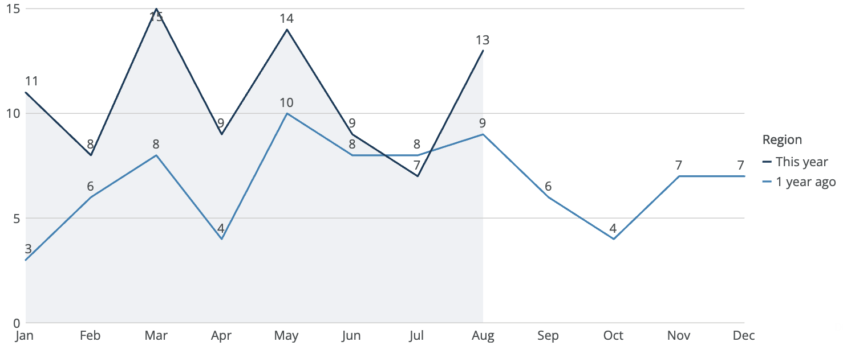
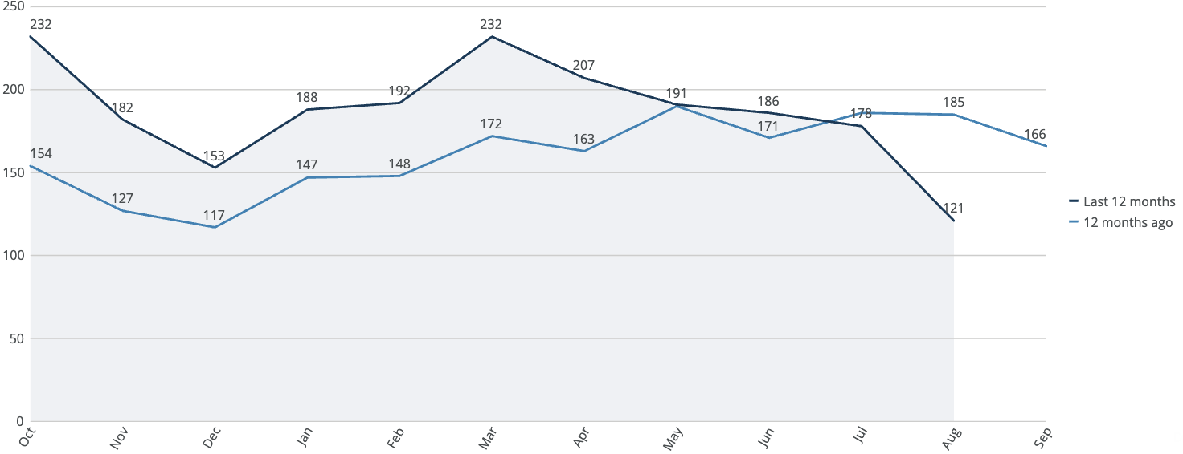
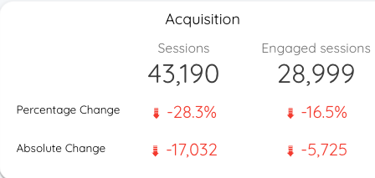
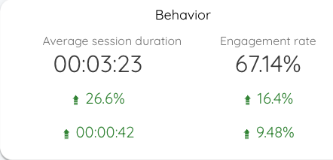
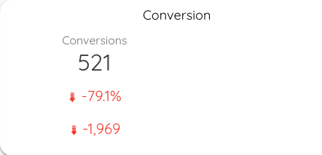
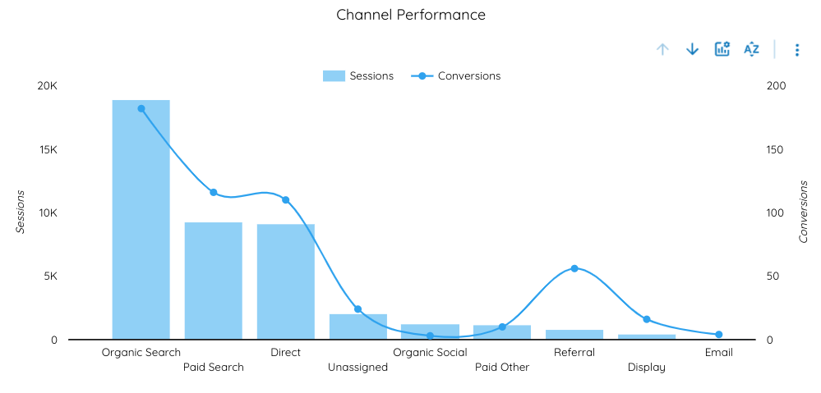
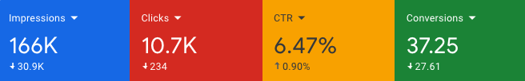
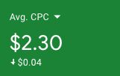
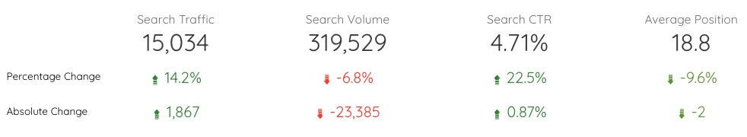
PBL: Summary
Leads
Contracts
August 2024: 121
August 2023: 185
August 2024: 13
August 2023: 9

Slide 12
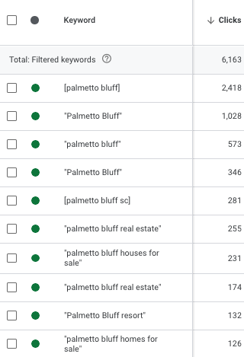
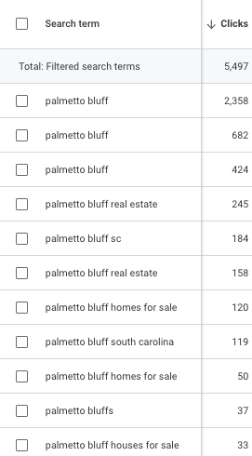
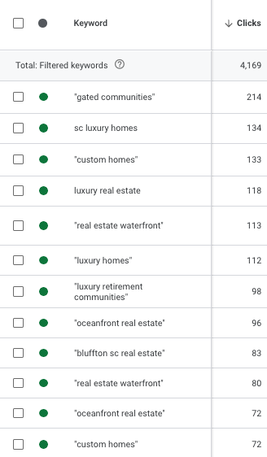
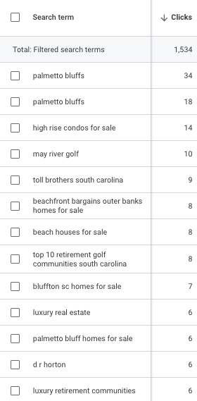
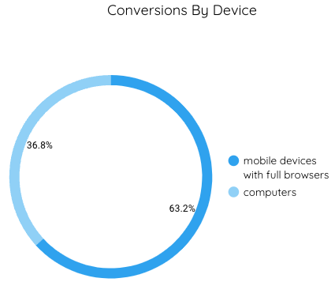
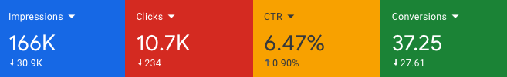
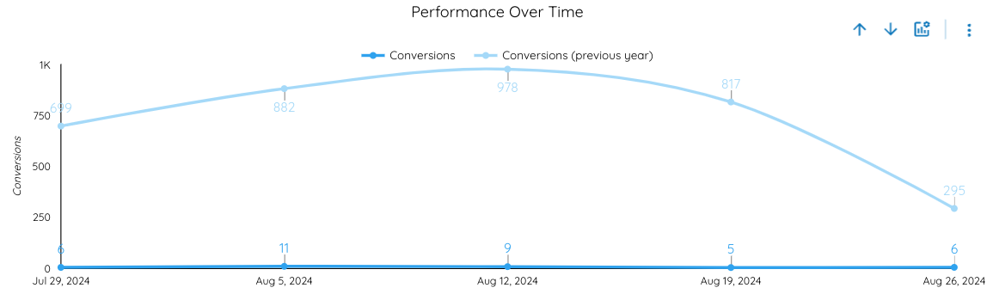
Branded
Non-Branded
PBL: Paid
MoM Comparison
Paid metrics saw a small decrease in metrics MoM. Clicks and conversions saw decreases across the board, with CTR seeing a small increase. Branded keywords still bring in the most traffic. Some non-branded keywords are showing branded search terms as a result of adding broad match keywords through the broad match test. Golf and retirement related keywords are still among the top search terms.
Mobile devices take the majority conversions when compared with computers.

Slide 13
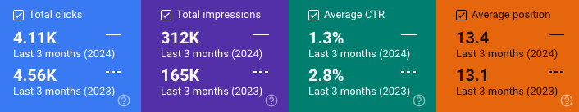
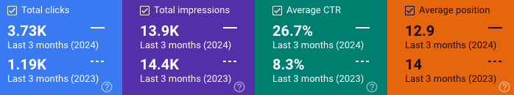
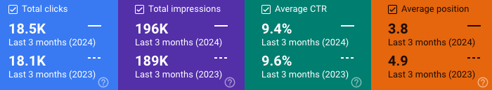
PBL: Organic Users & Traffic
YoY Comparison of Organic traffic
Summary:
“Live” ecosystem traffic has decreased slightly as avg pos and CTR are moving in the wrong direction
Club-based query traffic has increased significantly
Branded (i.e. “palmetto bluff”) queries have increased due mainly to better avg pos
Live
“Club” Queries
Branded Queries

Slide 14
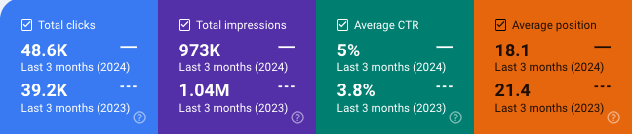
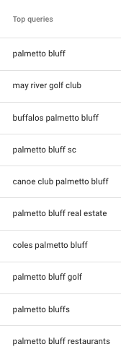
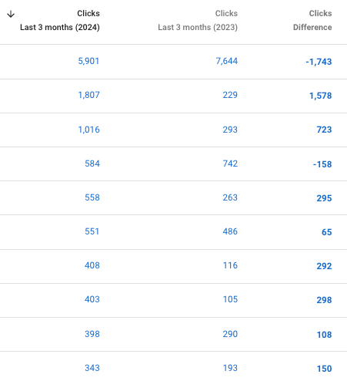
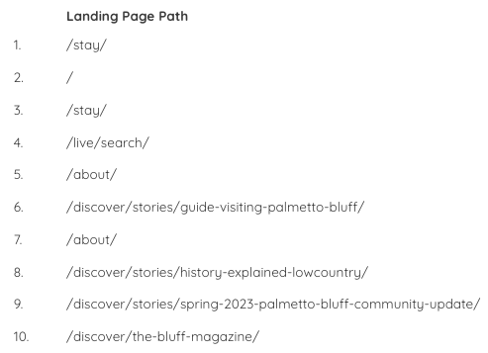
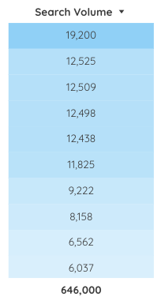
PBL: Organic Users & Traffic

Slide 15
PBL: Takeaways
Overall website traffic is down overall, but engagement is up
  Branded and club-based queries have performed well
  However engagement metrics on the website has seen large increases, indicating that current users are engaging with the material
Re-analysis on campaigns
  To increase paid traffic , we’re revamping the campaign structure for Palmetto Bluff to maximize potential. While the current campaigns are gaining traction, we've identified a more effective approach to achieve better results.
  Combining the “Live” search campaigns instead of having geographical differences
Budget reallocation
  We will also be re-allocating budgets to the new campaigns that are getting created
Reduced stay budget
  From $40/day to $20/day
Sitelink project implementation
  Using what we’ve created last month, we will implement the newly created sitelink experiment. Google Ad sitelinks are the 3 to 5 additional links at the bottom of an ad. Roughly ⅔ of all ad clicks are through sitelinks rather than the main ad link, and avg click-through-rate for sitelinks vs ads is 20-40% higher. Each campaign will contain 4-5 sitelinks specific to the campaign that leads to a relevant landing page
Improve ad strength
  Improving ad strength by adding more varied text and image assets to all campaigns. Some of our ads have only “good” or “average” ad strength as seen by Google. By increasing them to “great” or “excellent”, our ad relevance, quality, and effectiveness will increase along with it

Slide 16
PBL: Questions?

Slide 17
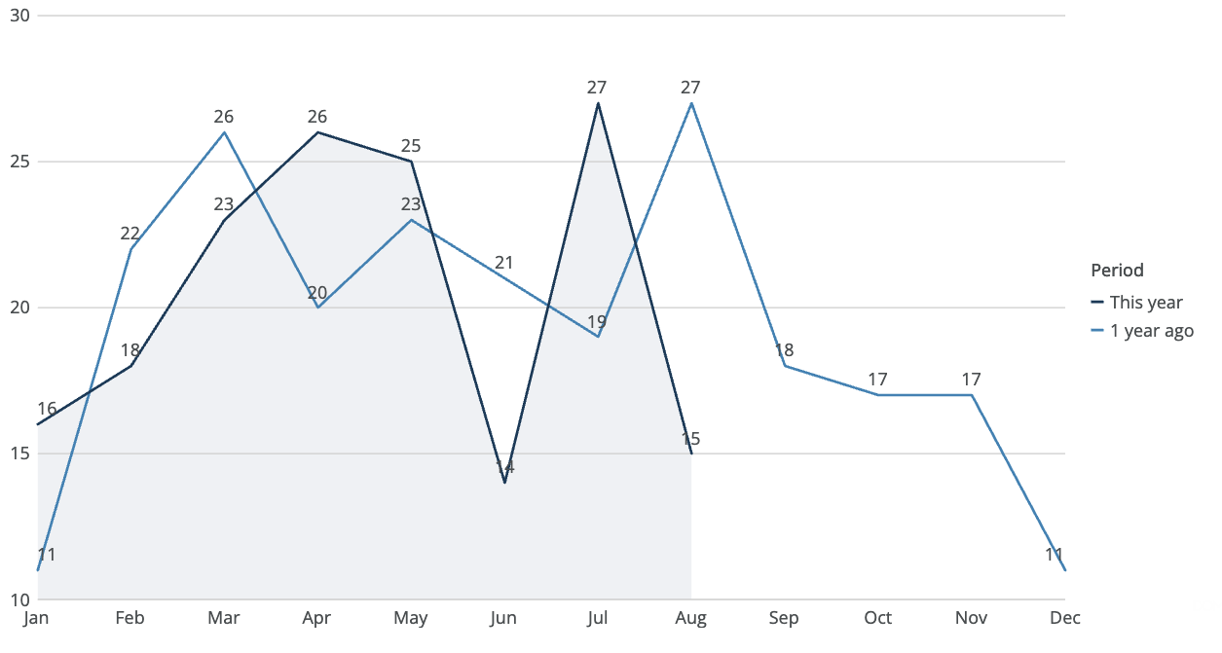
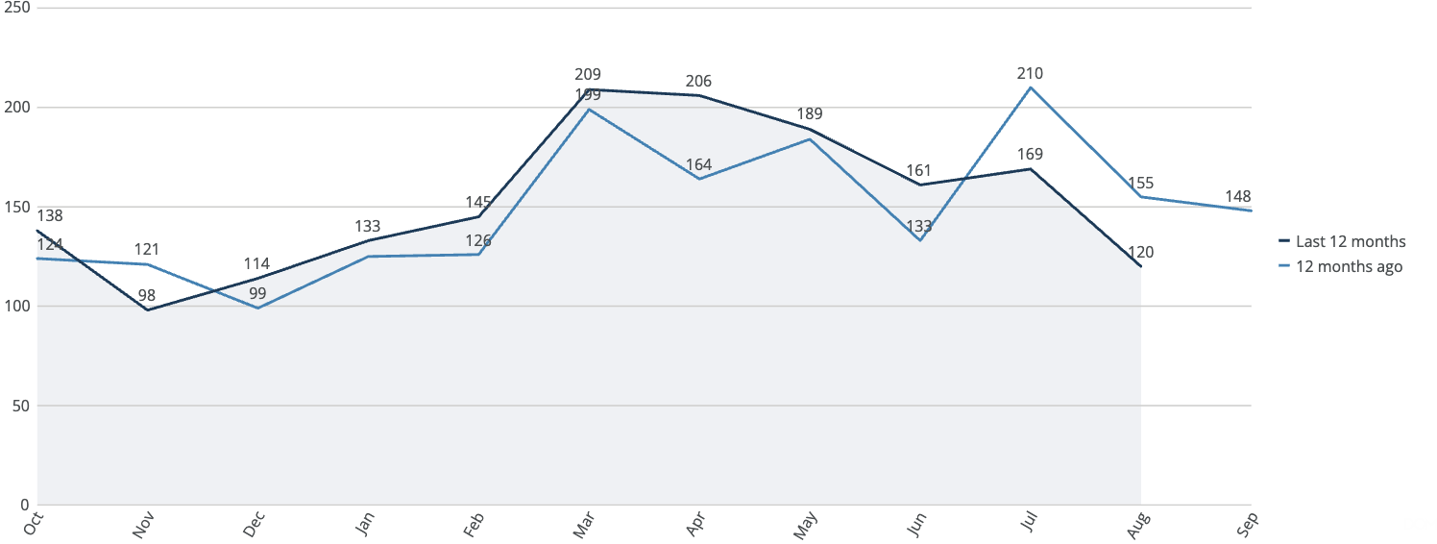
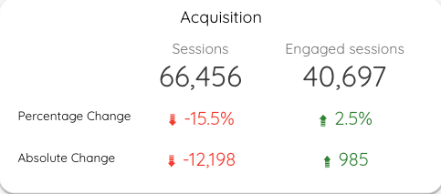





KIRE: Summary
Leads
Contracts
August 2024: 120
August 2023: 125
August 2024: 17
August 2023: 22

Slide 18







Branded
Non-Branded
KIRE: Paid
MoM Comparison
Both branded and non-branded keywords saw similar decreases in clicks. However, non-branded keywords saw a small uptick in conversions. This shows that though we have less users, site content is engaging and resulting in conversions.
The highest number of conversions seems to occur during the middle of the month, it may prove useful to off-load budget during the start and end of the month to push more for mid-month conversions.
Almost all conversions were made through mobile devices.

Slide 19



KIRE: Organic Users & Traffic
YoY Comparison of Organic traffic
Summary:
Listing traffic has decreased slightly. A significant proportion of the organic queries are address-based
General Real Estate ecosystem traffic increased as avg pos improved
Branded (i.e. “kiawah”) queries have increased due mainly to better avg pos and CTR
Listings
Real Estate
Branded Queries

Slide 20




KIRE: Organic Users & Traffic

Slide 21
KIRE: Takeaways
Overall metrics show a positive trend
  Number of website sessions are down, but engagement metrics are notably up
    Shows that fewer users are visiting the site but those who are more engaged
  Paid search shows decreases in clicks for both MoM and YoY periods
    CTR shows significant increases in both periods
Paid search account maintenance
  Keyword optimizations
  Ad copy updates
  Bid adjustments for locations
Competitor campaign optimization
  Added additional competitors as keywords to competitor campaign
Re-created broad match test
  Kiawah Island was the only property that used a Google-led experiment instead of a manually created broad match test. Since Google-led experiments are more limited, the experiment ended early and we were unable to adjust the time frame. Additionally, Google said the results were inconclusive, so we built out a broad match test as we did for the other properties.
Sitelink project implementation
  Using what we’ve created last month, we will implement the newly created sitelink experiment. Google Ad sitelinks are the 3 to 5 additional links at the bottom of an ad. Roughly ⅔ of all ad clicks are through sitelinks rather than the main ad link, and avg click-through-rate for sitelinks vs ads is 20-40% higher. Each campaign will contain 4-5 sitelinks specific to the campaign that leads to a relevant landing page
Improve ad strength
  Improving ad strength by adding more varied text and image assets to all campaigns. Some of our ads have only “good” or “average” ad strength as seen by Google. By increasing them to “great” or “excellent”, our ad relevance, quality, and effectiveness will increase along with it

Slide 22
KIRE: Questions?

Slide 23








BRP: Summary
Leads
August 2024: 57
August 2023: 39

Slide 24







BRP: Paid
Branded
Non-Branded
MoM Comparison
Overall traffic for paid search is up. Branded terms saw a sharp increase in conversions in August with a small increase in clicks. Non-branded terms saw a decrease in conversions with a small increase in clicks.
Mobile devices see a large percentage of conversions, followed by desktop.

Slide 25



BRP: Organic Users & Traffic
YoY Comparison of Organic traffic
All Organic Traffic
Summary:
Organic traffic is up overall
“Indendent Living” page traffic is up, but absolute values are still relatively small
Branded (i.e. “seafields”) queries have increased along with better avg pos, but still a small gain for YoY
Independent Living
Branded Queries

Slide 26



BRP: Organic Users & Traffic

Slide 27
BRP: Takeaways
Overall search traffic is down for organic channels
  Website and organic search show notable decreases in sessions and clicks
  Paid search shows increases in all metrics across the board. Last month’s optimizations are effective and we will continue to optimize.
Bid adjustments for top performing counties
  Took the top performing county data from the past couple months and implemented +25%/50% bid adjustments to get more conversions.
  Top performers were chosen based on high conversion/click data.
Remarketing for seasonality
  We will look into strategies to implement remarketing as we approach the latter portion of the year.
Sitelink project implementation
  Using what we’ve created last month, we will implement the newly created sitelink experiment. Google Ad sitelinks are the 3 to 5 additional links at the bottom of an ad. Roughly ⅔ of all ad clicks are through sitelinks rather than the main ad link, and avg click-through-rate for sitelinks vs ads is 20-40% higher. Each campaign will contain 4-5 sitelinks specific to the campaign that leads to a relevant landing page
Improve ad strength
  Improving ad strength by adding more varied text and image assets to all campaigns. Some of our ads have only “good” or “average” ad strength as seen by Google. By increasing them to “great” or “excellent”, our ad relevance, quality, and effectiveness will increase along with it

Slide 28
BRP: Questions?

Slide 29
Thank You
July 2024 Monthly Reporting

