Slide 1
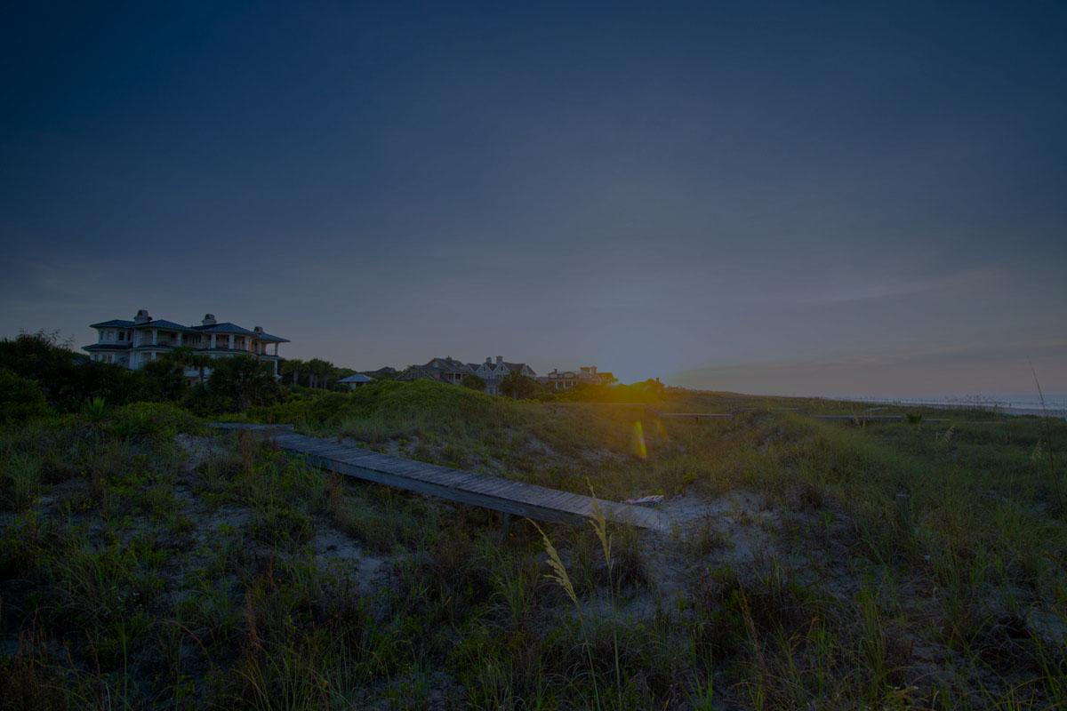
South Street Partners
2025 July Report

Slide 2
July Reporting Focus
July 1 - 31, 2025
Paid media inflation & efficiency drift
CPCs are rising and CTR softening where budgets scaled—e.g., PBL Jan→Jun CPC and CPA climbed while CTR fell (p.10), and CLF YoY CPC ↑ with clicks ↓ (pp.25–26). KIRE is the exception with improving CPA through June (p.15).
Report Needed: CPC, CTR, CPA by campaign type and the marginal return of added spend.
Display’s expanding role (mixed impact)
Display is broader this year and typically lowers CTR but can still convert: PBL display CTRs are “extremely high” (pp.7–8); KIRE got 60 of ~183 conversions from display (p.17); Salamander added display and CTR dropped as expected (p.31).
Report Needed: display share of spend/clicks/conversions + a creative leaderboard by CTR/conv.
Organic visibility up; CTR under pressure
Impressions and rankings are trending up while CTR dips as reach widens—PBL (p.7), KIRE (p.17), CLF (p.26). Also, AI Overviews and new SERP features are an opportunity.
Report Needed: impressions, clicks, CTR, avg position by topic/landing page, plus AIO session share.
Fewer leads, bigger deals, sales rebound
Lead and transaction counts are softer, but closed volume is up: PBL YTD closed price +17% with fewer leads/txns (pp.5–6); CLF closed price +53% YTD with leads down and 74% of sales from digital (pp.21–22).
Report Needed: Average sale price by channel and lead→sale conversion.
Notes:
PBL Sales Activity

Slide 3
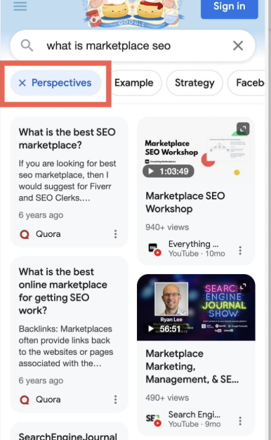
Social Media Strategy Changes
Social Media is becoming more integrated with search:
Google crawls social media platforms, treating them like websites, to find and index content based on keywords, themes, and user intent.
When a user searches for something, Google may display relevant social media content alongside traditional website results.
Google has introduced a "Perspectives" filter in search results, which can include social media content, especially for queries where users are looking for personal experiences and opinions.
While Google doesn't explicitly state that social signals are a direct ranking factor, social media engagement can indirectly influence SEO performance by indicating content relevance and driving traffic.
Notes:
PBL Sales Activity

Slide 4
Palmetto Bluff
July Report

Slide 5
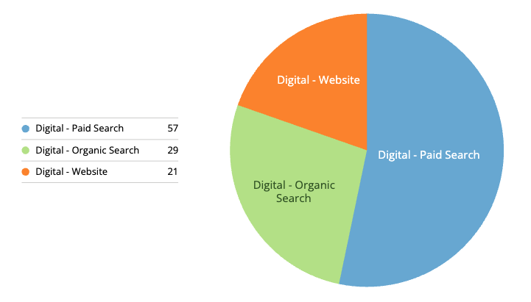
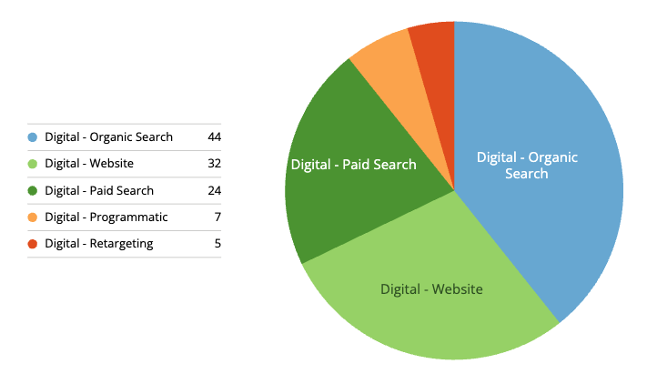
PBL Sales Activity
July 1 - 31, 2025
Digital-only [Paid/SEO] Leads: Previous Month
Digital Leads
Phone/Email
Form Leads
Walk-ins
Transactions
Sum of Closed Price
108
1
107
0
0
-
YoY 112 ⬇ 3%
YoY 3 -
YoY 106 ⬆
YoY 3 -
YoY 3 -
YoY $2,579,500
Digital-only [Paid/SEO] Leads: YTD Comparison
Digital Leads
Phone/Email
Form Leads
Walk-ins
Transactions
Sum of Closed Price
819
11
776
0
12
$26,994,000
YoY 888 ⬇ 7%
YoY 18 ⬇ 38%
YoY 842 ⬇ 8%
YoY 5 ⬇
YoY 14 -
YoY $26,315,970 ⬆ 17%
Digital Leads by Channel
Previous Month
2024
Notes:
PBL Sales Activity

Slide 6
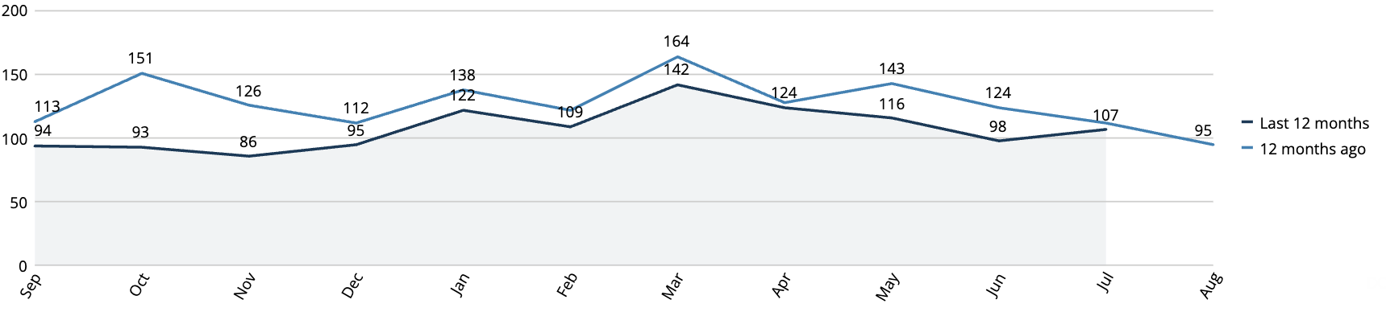
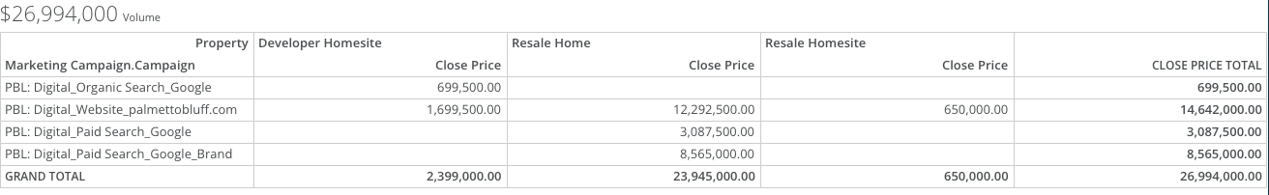
PBL Digitally-driven Leads & Sales
July 1 - 31, 2025
Notes:
PBL Sales Activity

Slide 7

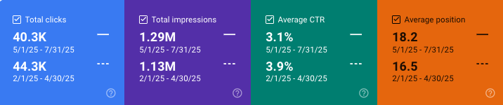
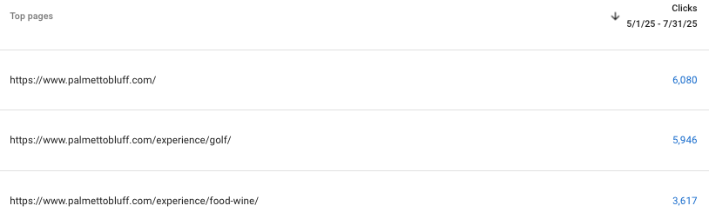
Paid Overview
July 1 - 31, 2025
Key Takeaways:
Overall, metrics are continuing to perform well for paid
Clicks saw a notable increase, with avg CPC decreasing and conversions remaining stable
CTR continues to see a large increase YoY since the restructure
Key Takeaways:
Overall, organic saw small dips in performance over a 3 month period
Clicks saw a slight decrease, with impressions seeing a notable increase, leading to a sharp drop in CTR
Average position saw a slight increase over the 3 month period
Clicks
Avg. CPC
CTR
Conversions
17.9K
$1.45
9.26%
63.97
⬆6.91K
⬇$0.89
⬆ 3.68%
⬇0.89
Summary:
The Broad Match campaign continues to lead in conversions within the account, holding 31/63.97 total conversions
  Search term audits are continually being done to ensure that all clicks are relevant
Overall, the restructure continues to show improvements within the ad account. Metrics have increased, with most notably the avg CPC remaining low since the restructure. It may prove useful to attempt the same strategy with the Cliffs account
The recently added display ads show extremely high CTRs in terms of industry benchmarks
Organic Overview
Past 3 Months vs Previous 3 Months
Top Clicked Landing Pages

Slide 8
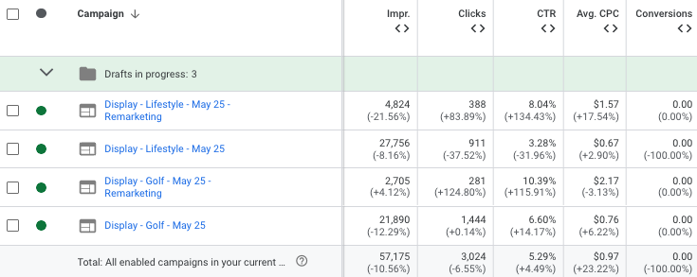




PBL Display Performance Update (client request)
July 1 - 31, 2025
Top Performing Creative (by clicks)
455
316
445
317
Summary:
Overall, engagement metrics for display ads have increased in July. Though impressions and clicks have both dropped, CTR showed notable increases across 2 of the campaigns, with CTR overall for these campaigns remaining high in terms of typical display benchmarks
The top performing creative all have engaging design with clear contrast CTA buttons
  It will prove useful to continue this trend with all future creative
All of the top performing creative were part of the General display campaigns. The remarketing still performed well, but the top 8 clicked pieces of creative were part of the General campaign
Notes:
High performers over paid, content, creative and queries
Include medium of actual conversion- call in or walk in
Look into forms
Look into conversion path and average number of touches before converting
Instead of good/bad- we want to see what is good now, what we need to keep in mind in the future - specify the timeline

Slide 9
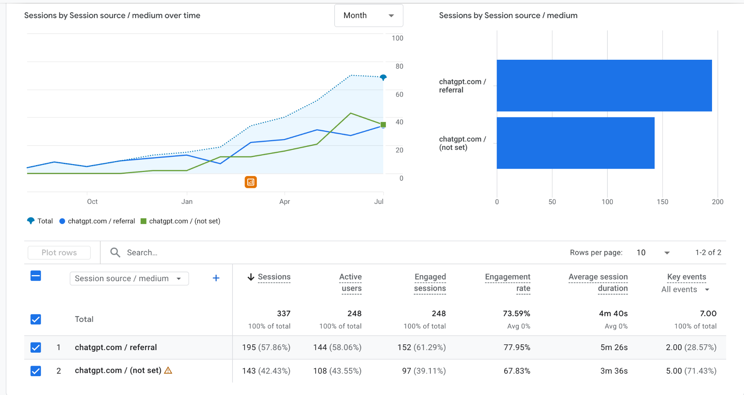
PBL AI Performance
July 1 - 31, 2025
Notes:
High performers over paid, content, creative and queries
Include medium of actual conversion- call in or walk in
Look into forms
Look into conversion path and average number of touches before converting
Instead of good/bad- we want to see what is good now, what we need to keep in mind in the future - specify the timeline

Slide 10
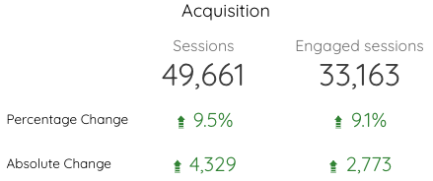
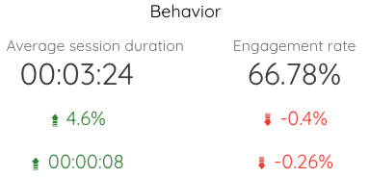
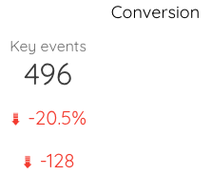
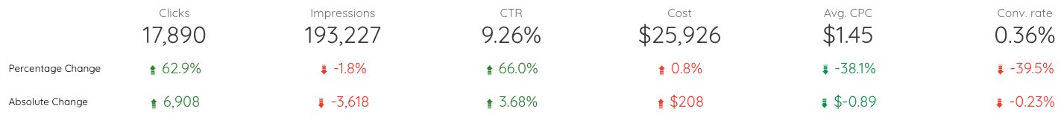
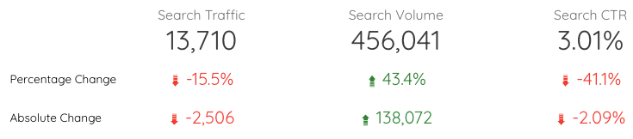
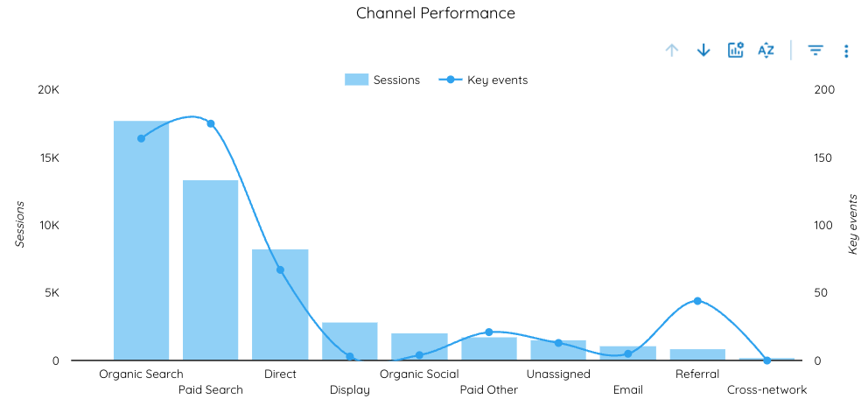
PBL July Overview (YoY Comparison)
July 1 - 31, 2025
Website
Ads
Organic
In May 2024, display ads generated 474,590 total impressions. In 2025, display ads garnered 144,818 total impressions, resulting in a sharp decrease YoY.
Notes:
High performers over paid, content, creative and queries
Include medium of actual conversion- call in or walk in
Look into forms
Look into conversion path and average number of touches before converting
Instead of good/bad- we want to see what is good now, what we need to keep in mind in the future - specify the timeline

Slide 11
PBL: Mid-Year Ads Performance Summary
January 1 - June 30, 2025
Day | Clicks | Impressions | Cost | Conversions | CTR | CPC | CPA | Sessions/$
January | 12,935 | 98,219 | $15,865.51 | 42.81 | 13.17% | $1.58 | $142.47 | 1.23
February | 11,004 | 83,168 | $14,177.28 | 37.24 | 13.23% | $1.90 | $144.83 | 1.29
March | 13,293 | 97,728 | $20,317.49 | 62.48 | 13.60% | $1.93 | $161.64 | 1.53
April | 13,720 | 102,902 | $21,941.13 | 79.22 | 13.33% | $2.08 | $198.86 | 1.60
May | 14,491 | 136,887 | $25,122.37 | 59.59 | 10.59% | $2.49 | $237.00 | 1.73
June | 16,400 | 183,529 | $25,461.27 | 60.27 | 8.94% | $2.70 | $261.26 | 1.55
Impressions and Clicks: Increases in clicks and impressions directly correlate with seasonal budget increases. Notably, impressions surged dramatically between April (102,902) and June (183,529), reflecting higher budgets but also potentially broader exposure.
Cost & CPC: CPC rose steadily ($1.58 in January → $2.70 in June), indicating increased competition and reduced efficiency as spend scaled up.
Click-Through Rate (CTR): CTR gradually declined from a high of around 13% (Jan-April) to 8.94% in June. Lifestyle & Display campaigns the primary culprits here.
Conversions & CPA: Conversions peaked sharply in April (79.22) but did not maintain momentum despite ongoing budget increases. CPA rose significantly from January ($142.47) to June ($261.26), signaling diminishing conversion returns despite higher investment.
Notes:
PBL Sales Activity

Slide 12
PBL Action Items
For Client
For PHI
Create report audit for CIDs, UTMS, phone numbers, & URLs

Slide 13
Kiawah Island
July Report

Slide 14
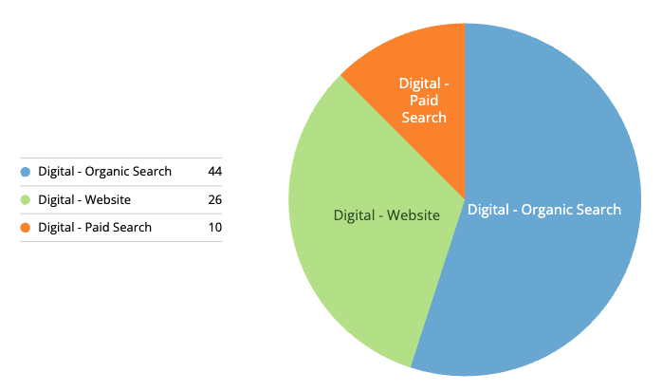
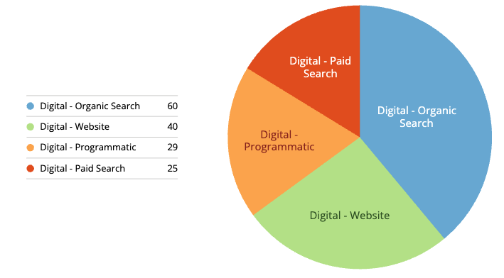
KIRE Sales Activity
July 1 - 31, 2025
Digital-only [Paid/SEO] Leads: Previous Month
Digital Leads
Phone/Email
Form Leads
Walk-ins
Transactions
Sum of Closed Price
154
33
119
1
4
$18,315,170
YoY 80 ⬆ 92%
YoY 14 ⬆ 136%
YoY 66 ⬆ 80%
YoY 1
YoY 5 -
YoY $7,230,000 ⬆ 153%
Digital-only [Paid/SEO] Leads: YTD Comparison
Digital Leads
Phone Leads
Form Leads
Walk-ins
Transactions
Sum of Closed Price
682
100
592
3
16
$59,415,170
YoY 1
YoY 662 ⬆ 30%
YoY 582 ⬇ 9%
YoY 66 ⬆ -
YoY 507 ⬇ 6%
YoY 19 -
YoY $64,775,170 ⬇ 8%
YoY 83 ⬆ 30%
YoY 572 ⬆ 30%
YoY 3 -
Digital Leads by Channel
Previous Month
2024
Notes:
PBL Sales Activity

Slide 15
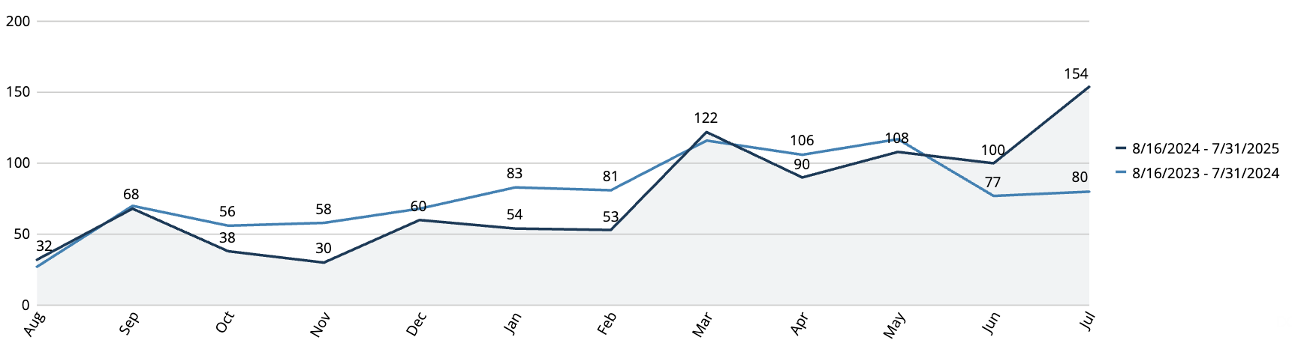
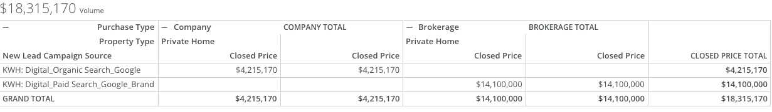
KIRE Digitally-driven Leads & Sales
July 1 - 31, 2025
Notes:
PBL Sales Activity

Slide 16
KIRE: Monthly Ads Performance Summary
January 1 - June 30, 2025
Day | Clicks | Impressions | Cost | Conversions | CTR | CPC | CPA | Sessions/$
January | 3,546 | 33,537 | $7,778.59 | 75 | 10.57% | $1.63 | $99.07 | 2.19
February | 4,241 | 38,715 | $9,649.47 | 86 | 10.95% | $1.85 | $136.40 | 2.28
March | 5,990 | 48,035 | $13,033.90 | 138 | 12.47% | $1.81 | $135.25 | 2.18
April | 4,844 | 48,085 | $14,833.76 | 121 | 10.07% | $1.67 | $121.85 | 3.06
May | 6,468 | 97,346 | $16,411.23 | 156 | 6.64% | $1.53 | $104.17 | 2.54
June | 7,182 | 106,134 | $16,481.52 | 178 | 6.77% | $1.42 | $96.71 | 2.29
Impressions and Clicks: Steadily increased month-over-month, aligning closely with the seasonal increase in ad spend. From January (3,546 clicks, 33,537 impressions, $7.8k spend) to June (7,182 clicks, 106,134 impressions, $16.5k spend), the growth in impressions significantly outpaced clicks, notably in May and June, indicating broader reach with slightly diminishing returns on incremental spend.
Cost & CPC: While costs increased seasonally, CPC notably decreased ($1.85 in February → $1.42 in June).
Click-Through Rate (CTR): CTR peaked in March (12.47%) before dropping to 6.64% in May and stabilizing in June (6.77%). The decline in CTR aligns with sharply increased impressions, suggesting a broader but potentially less engaged audience.
Cost Per Acquisition (CPA): Conversions consistently rose with spend, reaching a peak of 178 in June. Importantly, CPA improved month-over-month since February ($136.40) through June ($96.71).
Notes:
PBL Sales Activity

Slide 17
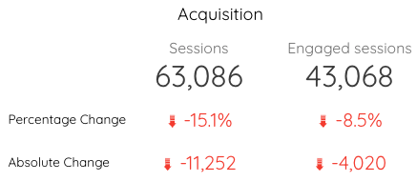
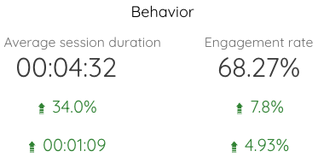
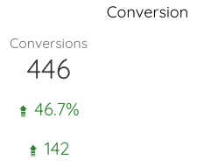
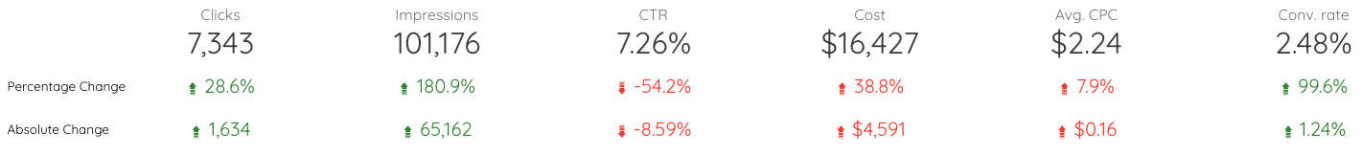
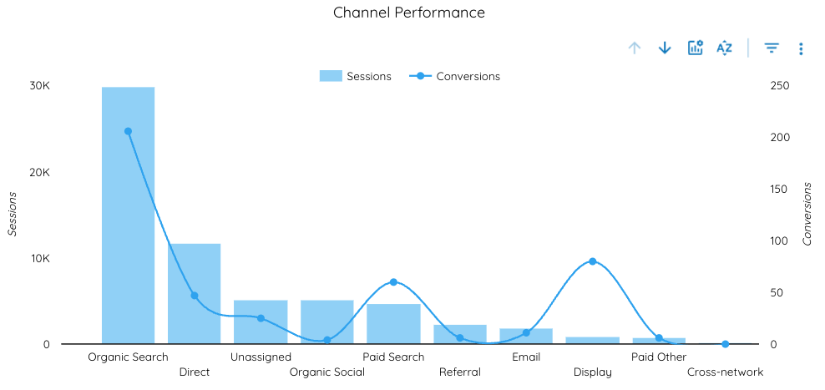
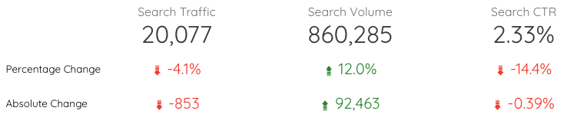
KIRE July Overview (YoY Comparison)
July 1 - 31, 2025
Website
Ads
Organic
Notes:
High performers over paid, content, creative and queries
Include medium of actual conversion- call in or walk in
Look into forms
Look into conversion path and average number of touches before converting
Instead of good/bad- we want to see what is good now, what we need to keep in mind in the future - specify the timeline

Slide 18
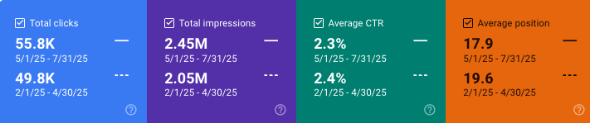
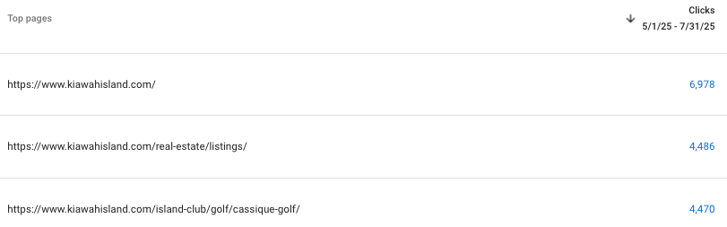
Paid Overview
July 1 - 31, 2025
Key Takeaways:
Overall, there were noticeable variations between metrics
Average CPC remained consistent
CTR saw a noticeable decrease - in July 2024 Kiawah ran exclusively high-intent search campaigns. In July 2025, display campaigns were introduced which accounts for the decrease
Conversions saw a large increase
Key Takeaways:
Overall, all metrics are trending positively for organic
Impressions and clicks saw notable increases over the 3 month period, with average CTR remaining consistent
Average position continues to decrease significantly, signaling we’re moving in the right direction organically
Clicks
Avg. CPC
CTR
Conversions
7.34K
$2.24
7.26%
182.99
⬆1.63K
⬆0.16
⬇8.59%
⬆111.10
Summary:
New Freshfields Real Estate Office campaign
  A new campaign was created for the Freshfields Real Estate Office (targeting 1km around office) to try and drive additional traffic
  The campaign has garnered 1 conversion in July (phone call), and we will continue to optimize
    $1,000 will be given to start a Meta campaign to drive additional awareness
Conversions
  Display drove a large amount of conversions this month (60/182.99), followed by the Broad Match campaign which drove 45.33
Organic Overview
Past 3 Months vs Previous 3 Months
Top Clicked Landing Pages

Slide 19
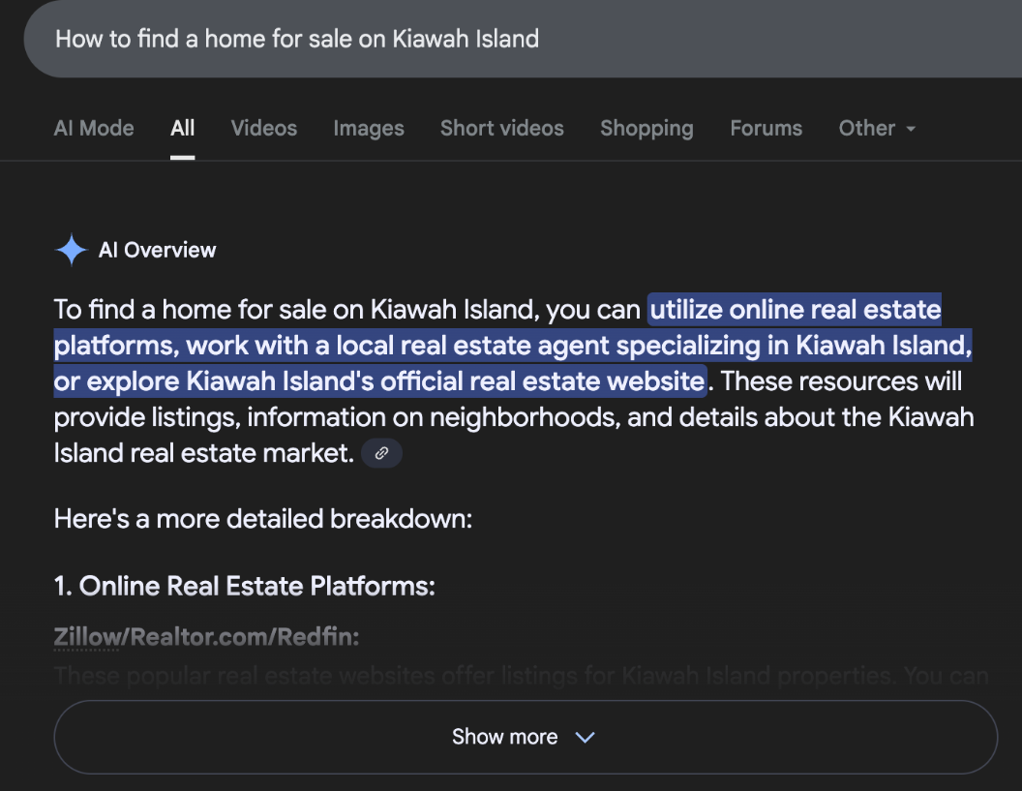
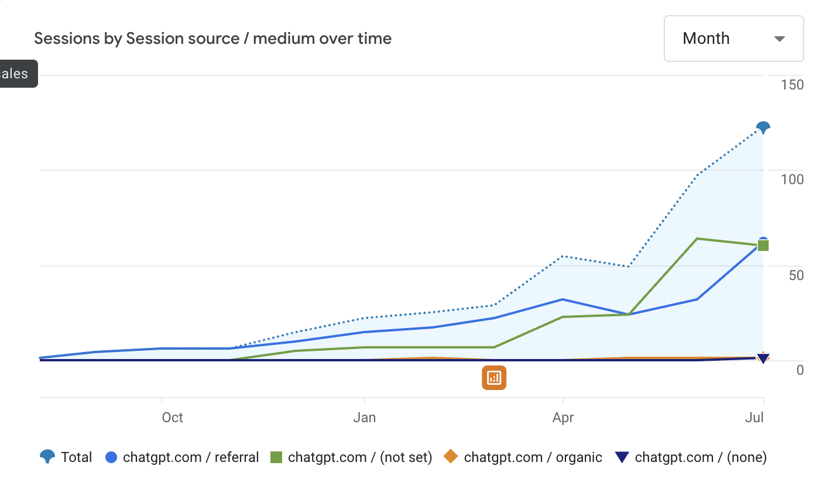
KIRE AI Overview Performance
July 1 - 31, 2025
Notes:
High performers over paid, content, creative and queries
Include medium of actual conversion- call in or walk in
Look into forms
Look into conversion path and average number of touches before converting
Instead of good/bad- we want to see what is good now, what we need to keep in mind in the future - specify the timeline

Slide 20
KIRE Action Items
For PHI
Create report audit for CIDs, UTMS, phone numbers, & URLs
For Client
Implement updated QR codes linking to new listings in all artwork (make sure to coordinate on UTM parameters

Slide 21
The Cliffs
July Report

Slide 22
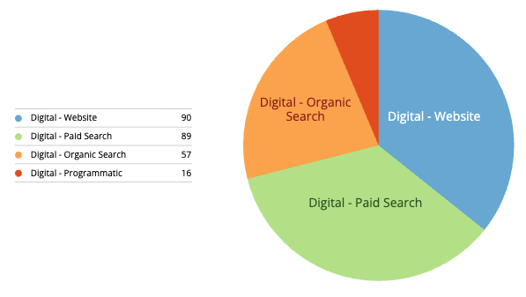
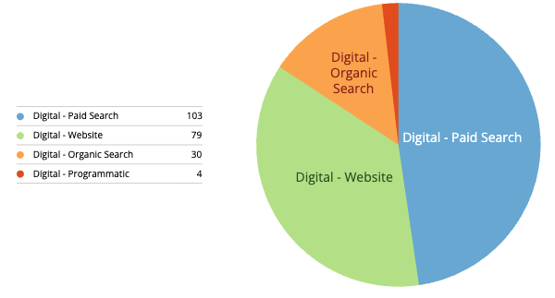
CLF Sales Activity
July 1 - 31, 2025
Digital-only [Paid/SEO] Leads: Previous Month
Digital Leads
Phone Leads
Form Leads
Walk-ins
Transactions
Sum of Closed Price
74% of Sales from Digital
216
33
179
4
6
$8,805,000
YoY 252 ⬇ 14%
YoY 39 ⬇15%
YoY 198 ⬇ 9%
YoY 2 ⬆100%
YoY 9 ⬇ 33%
YoY $10,192,040 ⬇ 13%
Digital-only [Paid/SEO] Leads: YTD Comparison
Digital Leads
Phone Leads
Form Leads
Walk-ins
Transactions
Sum of Closed Price
999
125
751
19
16
$52,258,500
YoY 1
YoY 1278 ⬇28%
YoY 221 ⬇43%
YoY 934 ⬇19%
YoY 28 ⬇32%
YoY 19 ⬇ 15%
YoY $34,052,290 ⬆53%
Digital Leads by Channel
Previous Month
2024
Notes:
PBL Sales Activity

Slide 23
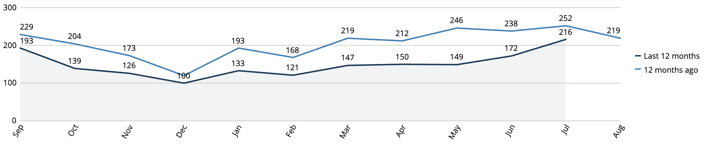
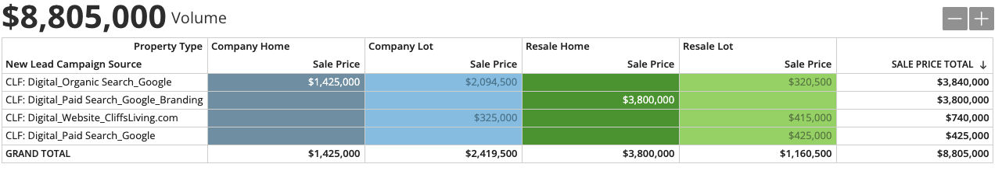
CLF Digitally-driven Leads & Sales
July 1 - 31, 2025
Notes:
PBL Sales Activity

Slide 24
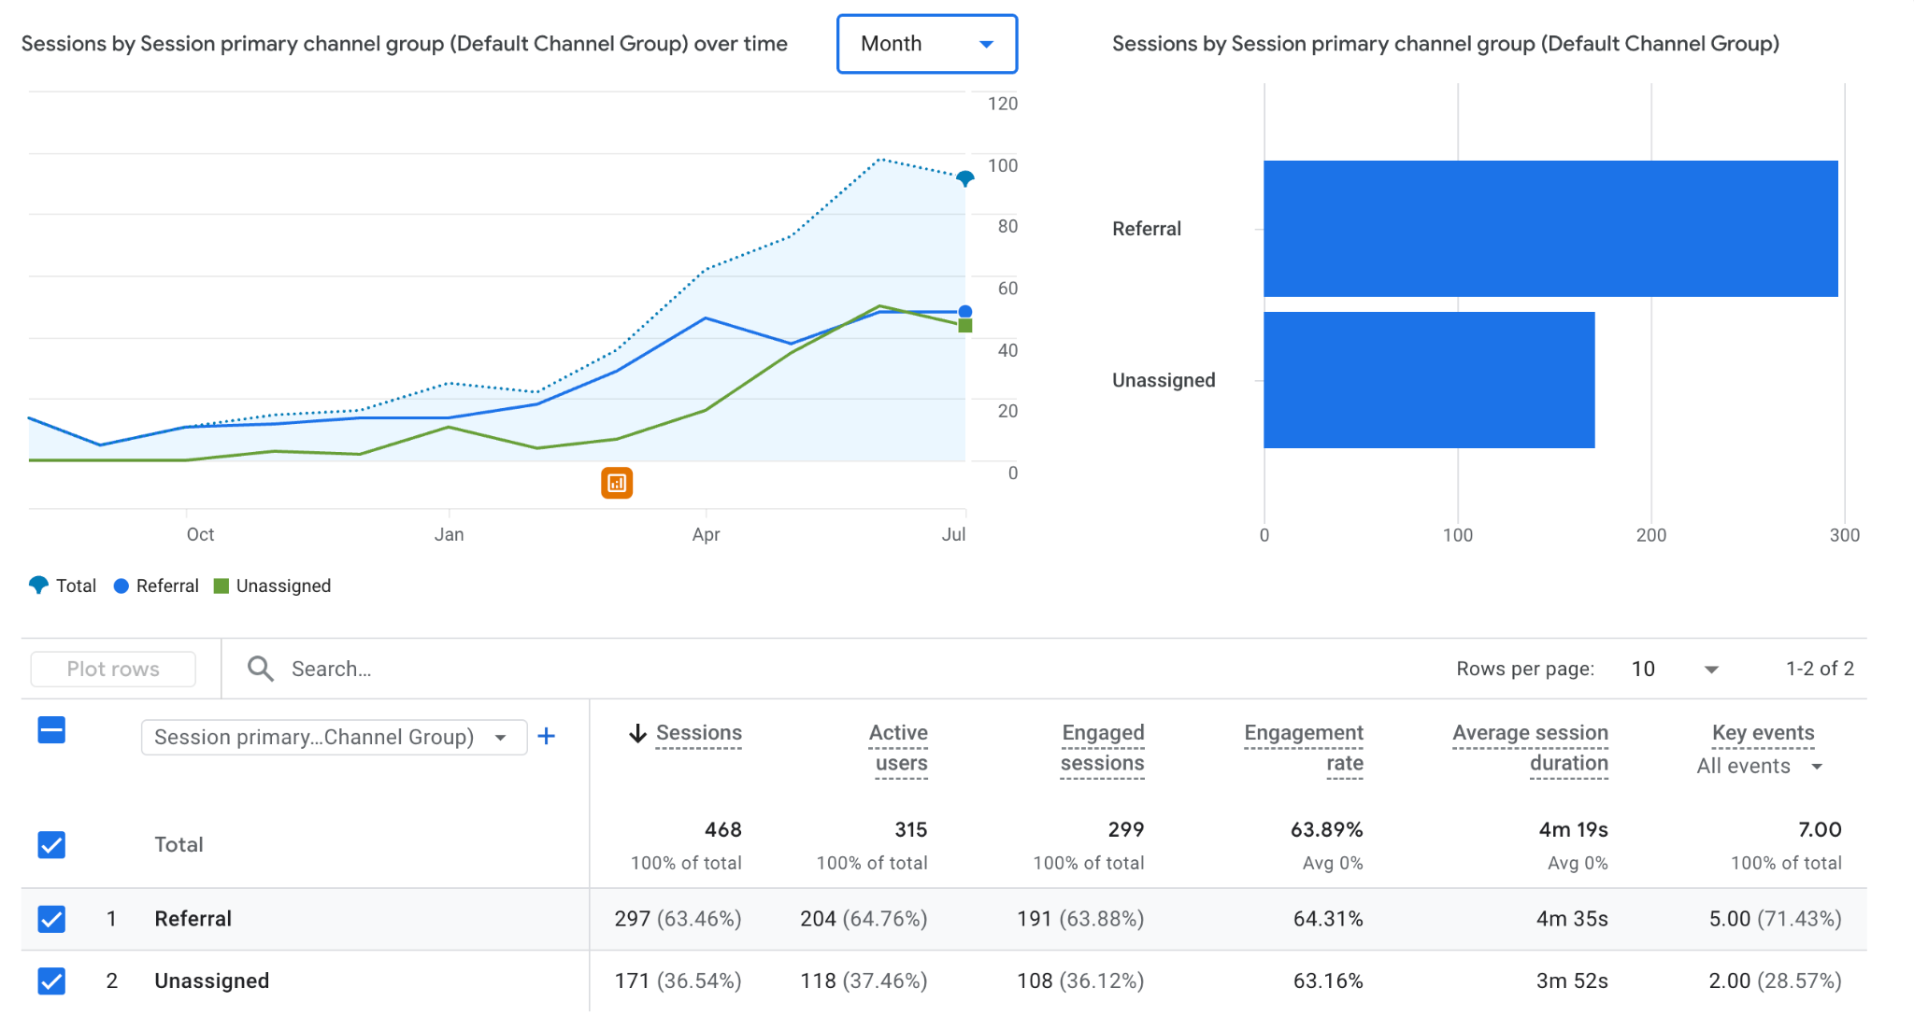
CLF AI Performance
July 1 - 31, 2025
Notes:
High performers over paid, content, creative and queries
Include medium of actual conversion- call in or walk in
Look into forms
Look into conversion path and average number of touches before converting
Instead of good/bad- we want to see what is good now, what we need to keep in mind in the future - specify the timeline

Slide 25
CLF: Monthly Ads Performance Summary
January 1 - June 30, 2025
Day | Clicks | Impressions | Cost | Conversions | CTR | CPC | CPA | Sessions/$
January | 13,674 | 137,758 | $12,013.22 | 165 | 9.93% | $0.88 | $72.81 | 0.88
February | 9,109 | 96,636 | $7,473.58 | 134 | 9.43% | $0.82 | $55.74 | 0.82
March | 11,339 | 110,457 | $11,899.04 | 159 | 10.27% | $1.05 | $74.64 | 1.05
April | 13,331 | 115,654 | $15,772.38 | 237 | 11.53% | $1.18 | $66.69 | 1.18
May | 14,199 | 140,396 | $16,776.10 | 189 | 10.11% | $1.18 | $88.95 | 1.18
June | 15,471 | 168,001 | $17,802.21 | 151 | 9.21% | $1.15 | $118.11 | 1.15
Impressions and Clicks: Growth in clicks and impressions consistently matched the seasonal rise in ad spend. Impressions notably climbed from January (137,758) to June (168,001), indicating steady audience expansion alongside increased budgets.
Cost & CPC: CPC increased moderately ($0.82 in February → $1.15 June), reflecting manageable competition, though higher CPC coupled with lower conversions is an area of concern.
Click-Through Rate (CTR): CTR remained relatively stable (9%-11.5%) despite increased impressions, peaking in April (11.53%). Slight declines in May (10.11%) and June (9.21%) suggest mild audience fatigue and/or decreasing ad relevance.
Conversions & CPA: Conversions reached a notable peak in April (237) alongside higher spend. However, despite continued budget growth, conversions declined in May (189) and June (151). CPA rose from a low of $55.74 in February to $118.11 in June, reflecting declining conversion efficiency despite larger budgets.
Notes:
PBL Sales Activity

Slide 26

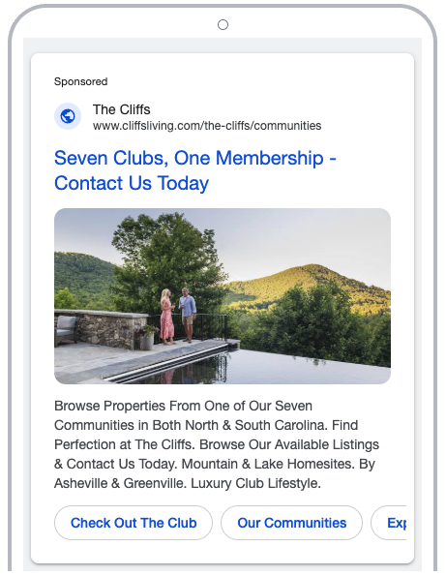
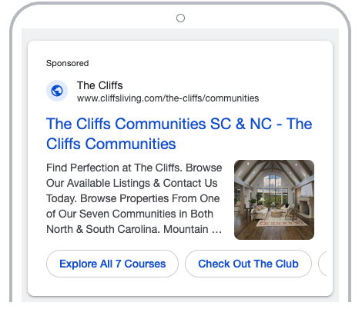

CLF Asset Best Performers
July 1 - 31, 2025
Consider revising display ads to improve message and CTA contrast
Notes:
High performers over paid, content, creative and queries
Include medium of actual conversion- call in or walk in
Look into forms
Look into conversion path and average number of touches before converting
Instead of good/bad- we want to see what is good now, what we need to keep in mind in the future - specify the timeline

Slide 27
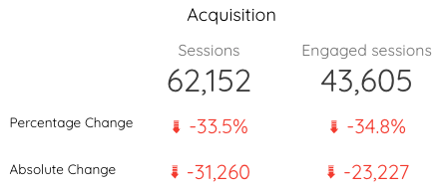
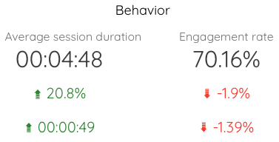
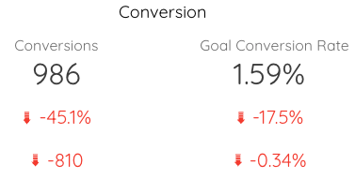
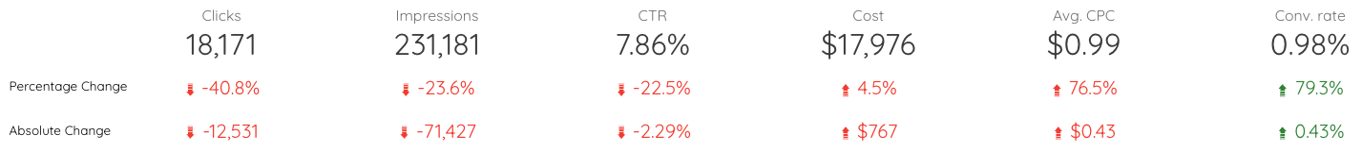
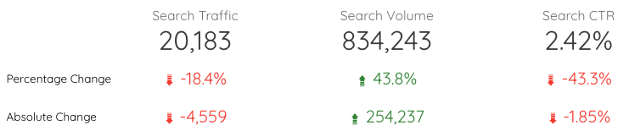
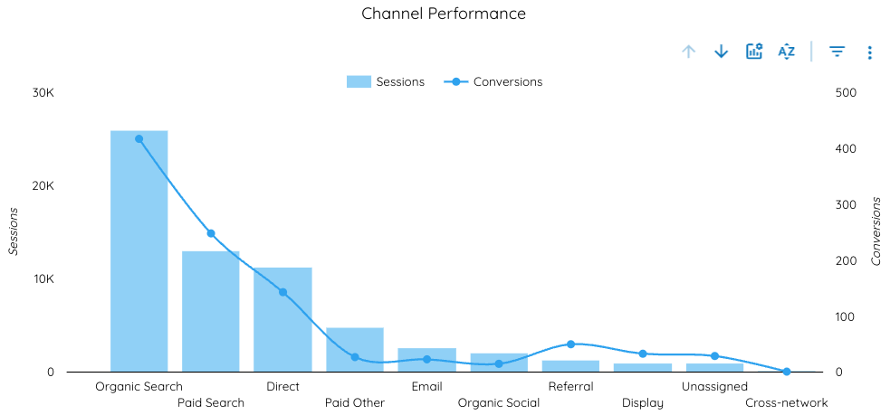
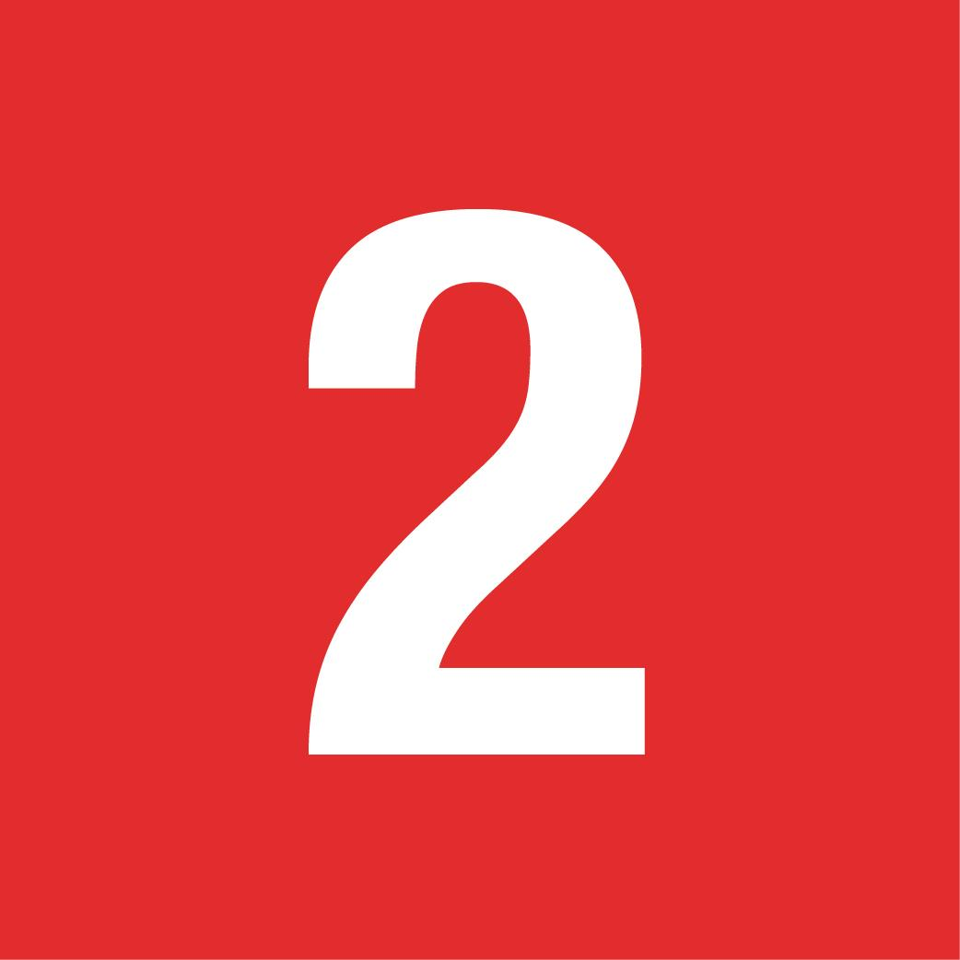
CLF July Overview (YoY Comparison)
July 1 - 31, 2025
Website
Ads
Organic
In May 2024, display ads garnered 264,315 impressions, while in 2025 they only garnered 140,396 impressions. This accounts for the large decrease in impressions & clicks.
The average CPC almost doubled YoY, which resulted in a large drop in clicks. CPC for search and display are increasing as more marketers join the auction. This increase is a result of increased competition.
Notes:
High performers over paid, content, creative and queries
Include medium of actual conversion- call in or walk in
Look into forms
Look into conversion path and average number of touches before converting
Instead of good/bad- we want to see what is good now, what we need to keep in mind in the future - specify the timeline

Slide 28
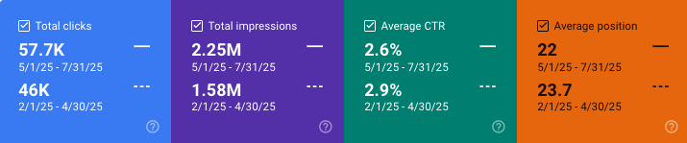
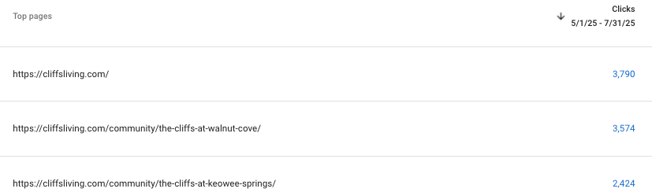
Paid Overview
July 1 - 31, 2025
Key Takeaways:
Overall, metrics saw notable fluctuations YoY
Clicks saw a large decrease, average CPC rose marginally, and average CTR showed slight decreases
Conversions continue to increase YoY
Key Takeaways:
Overall, all metrics are trending positively organically
Impressions and clicks saw very notable increase over the 3 month period, especially impressions
Due to the dramatic impression increase, CTR saw a slight decrease
Average position continues to decrease, showing we’re trending postiviely orgnically
Clicks
Avg. CPC
CTR
Conversions
18.2K
$0.99
7.86%
177.23
⬇12.5K
⬆ $0.43
⬇2.29%
⬆10.21
Summary:
The average CPC continues to increase- the difference is a lot lower than previous months where it almost doubled YoY, so we are trending in the correct direction
  This increase in CPC is a large result as to why clicks saw such large decreases YoY
  Campaigns like Dynamic and Brand saw the largest decreases in clicks: -57% and -45% respectively. We will look into optimization strategies to increase performance
  However, Brand and Dynamic are the highest converting campaigns, coming in together at 91.67/177.23 combined
Organic Overview
Past 3 Months vs Previous 3 Months
Top Clicked Landing Pages

Slide 29
CLF Key Takeaways
July 1 - 31, 2025
Address Paid Ad Performance: The near-doubling of CPC and the resulting 50% drop in clicks is the most urgent issue. Conduct a targeted audit of the paid search account to understand the drivers of the cost increase and find efficiencies. Re-evaluate keyword strategy and audience targeting to combat rising competition.
Improve Website Engagement: The 37% drop in website sessions and 52% drop in conversions needs immediate attention. Analyze the user journey to identify points of friction.
Refine Ad Creative: Revise display ads to improve the contrast of the message and call-to-action (CTA) to increase effectiveness.
Sitelink Analysis & Improvements: Complete the planned analysis of sitelink extensions to optimize ad structure and improve CTR.
Notes:
PBL Sales Activity

Slide 30
CLF Action Items
For Client
Walk-ins who self report as finding the office online are currently attributed to ‘organic search unknown’ - Kristie will update to ‘digital unknown’
For PHI
Create remarketing display campaign
Create report audit for CIDs, UTMS, phone numbers, & URLs
Look into Brand/Dynamic search campaigns

Slide 31
Salamander
July Report

Slide 32
Salamander Key Takeaways
July 1 - 31, 2025
Focus for next month: Protect the improving conversion efficiency while clawing back qualified clicks—tighten to top converting queries/audiences, rotate in new display assets, and restore budget where ROAS/CPA is strongest.
Notes:
PBL Sales Activity

Slide 33
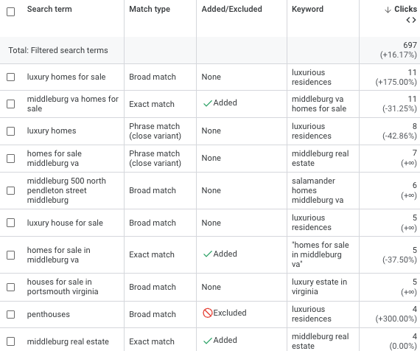
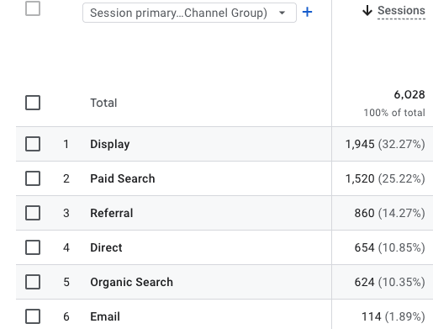
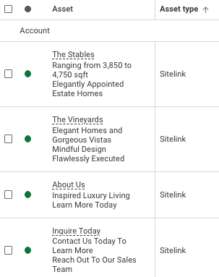
Paid Overview
July 1 - 31, 2025
MoM Comparison
Clicks
Avg. CPC
CTR
2.93K
$0.96
5.28%
⬆1.65K
⬇$0.60
⬇4.85%
Key Takeaways:
Overall, the paid account’s metrics remained steady
Clicks saw a large increase along with a notable decrease in avg CPC
CTR decreased, but this is expected as new display ads were introduced recently
Account-level sitelinks were added to the account to boost user experience/engagement

Slide 34
SAL Action Items
For Client
Send updated display creative
For PHI

Slide 35
Thank You

