Slide 1
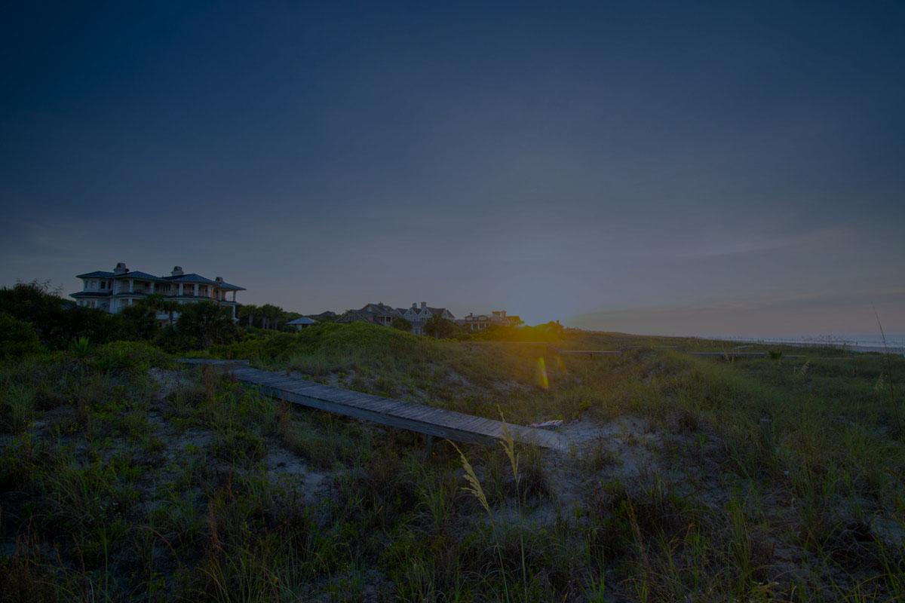
South Street Partners
2024-25 Performance & Strategy Report

Slide 2
2025-26 Reporting & Collaboration
Introductions & Session Overview
Lead & Sales Performance (Trailing 12 months w/ YoY comparisons)
Trend Identification & Discussion
  Key Initiatives in the last 12 months
  Performance trends (Search & Display)
Competitive Analysis by Project
What new factors have the greatest impact on Digital Visibility?
  EEAT as a filter for AI-based results inclusion
  AI overviews (AIO) & AI contributions to Search
  Social Media indexing by Google/Microsoft
What does all this mean for Digital Strategy going forward?
Notes:
PBL Sales Activity

Slide 3
Introductions - PHI Team
Glenn Harmon - Partner at Pinckney Harmon and strategic lead on the SSP account for approx 5 years
Noelle Erikson - Account Manager for all SSP projects
Shaina Kennedy - Content lead for the SSP account
Dennis Chen - Oversees Google Paid Media implementation and tactical analysis for all SSP projects
Notes:
PBL Sales Activity

Slide 4
PHI Contributions to Digital Marketing for SSP
Paid Media and Organic Visibility Implementations
  Google and Social Media Advertising
Content Writing/Deployment
  Concepting, Writing, and Uploading Blog Content
Competitive Analysis & Reporting
  Monitoring and Analyzing Competition for Visibility
Digital Visibility & Content Strategy
  Performance Analysis ⇨ Assess Vulnerabilities/Opportunities ⇨ Propose Strategic Adjustments
Goal-based Analytics & Reporting
  Lead/Revenue-based Monthly Reporting
Consulting & Collaboration on top-level Digital Strategy
  Top-level Strategy Sessions based on both Performance & the Macro Economic and Digital Environments
Notes:
PBL Sales Activity

Slide 5
Lead & Sales Performance
Trailing 12 months w/ YoY comparisons

Slide 6
Trailing 12 month Sales Activity
Aug 1, 2024 - July 31, 2025
PBL: Digital-only [Paid/SEO] Leads - YTD Comparison
Digital Leads
Phone/Email
Form Leads
Walk-ins
Transactions
Sum of Closed Price
% Total
1280
25
1255
0
31
$82,024,986
32%
YoY 1561 ⬇18%
YoY 27 ⬇ 7%
YoY 1520 ⬇ 8%
YoY 11⬇
YoY 28 ⬆ 11%
YoY $50,262,720 ⬆ 63%
22%
KIRE: Digital-only [Paid/SEO] Leads - YTD Comparison
Digital Leads
Phone/Email
Form Leads
Walk-ins
Transactions
Sum of Closed Price
% Total
916
107
801
5
27
$82,746,170
13%
YoY 972 ⬇ 5%
YoY 129 ⬇ 17%
YoY 840 ⬇ 4%
YoY 6 ⬇16%
YoY 35 ⬇22%
YoY $100,699,100 ⬇17%
13%
CLF: Digital-only [Paid/SEO] Leads - YTD Comparison
Digital Leads
Phone/Email
Form Leads
Walk-ins
Transactions
Sum of Closed Price
% Total
1865
286
1542
37
67
$91,720,813
48%
YoY 2515 ⬇ 25%
YoY 399 ⬇ 28%
YoY 2074 ⬇ 25%
YoY 39 ⬇ 5%
YoY 73 ⬇ 8%
YoY $75,774,614 ⬆ 21%
36%
82% of TTL in both periods
Notes:
PBL Sales Activity

Slide 7
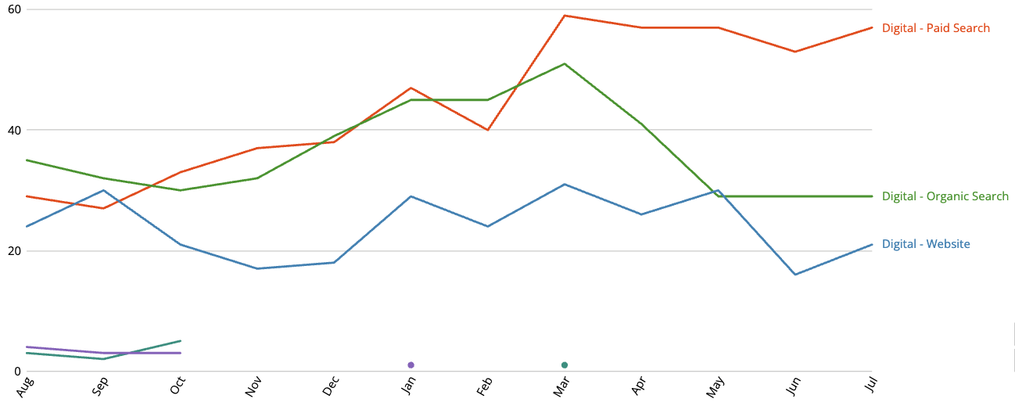
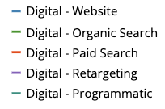
PBL Digitally-driven Sales Activity - Trailing 12 months
Aug 1, 2024 - July 31, 2025
PBL: Digital-only [Paid/SEO] Leads - YTD Comparison
Digital Leads
Phone/Email
Form Leads
Walk-ins
Transactions
Sum of Closed Price
% Total
1280
25
1255
0
31
$82,024,986
32%
YoY 1561 ⬇18%
YoY 27 ⬇ 7%
YoY 1520 ⬇ 8%
YoY 11⬇
YoY 28 ⬆ 11%
YoY $50,262,720 ⬆ 63%
22%
Notes:
PBL Sales Activity

Slide 8
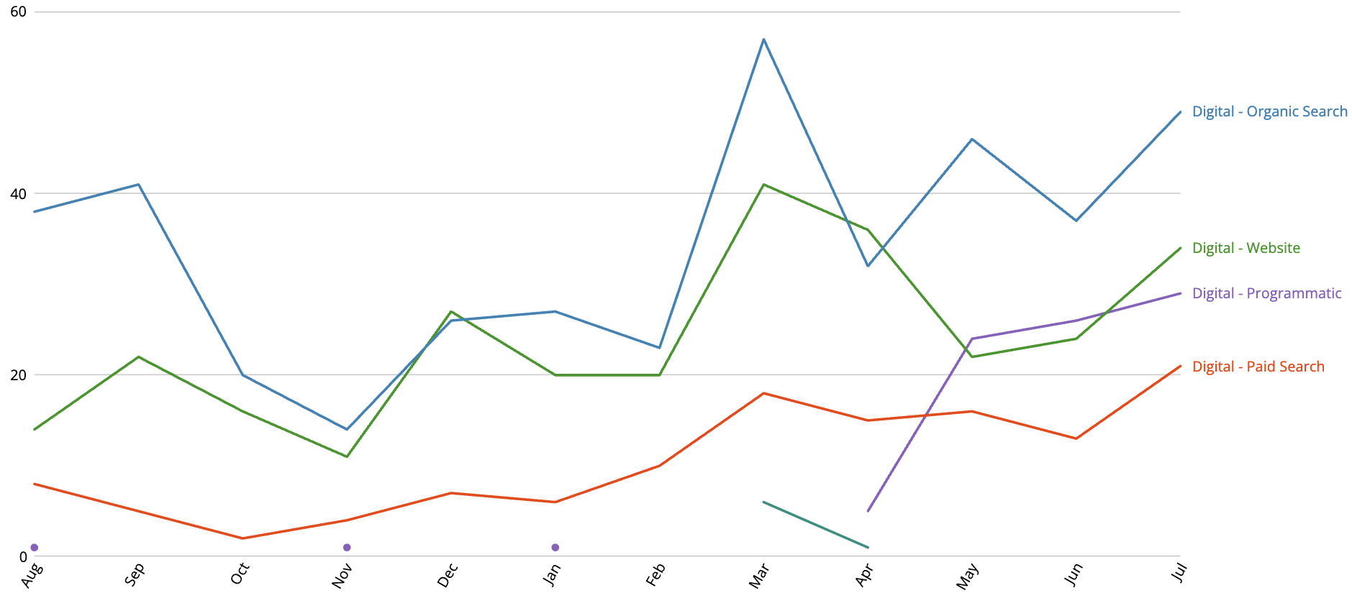
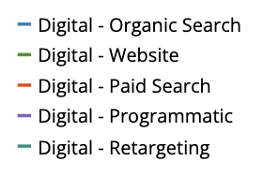
KIRE Digitally-driven Sales Activity - Trailing 12 months
Aug 1, 2024 - July 31, 2025
KIRE: Digital-only [Paid/SEO] Leads - YTD Comparison
Digital Leads
Phone/Email
Form Leads
Walk-ins
Transactions
Sum of Closed Price
% Total
916
107
801
5
27
$82,746,170
13%
YoY 972 ⬇ 5%
YoY 129 ⬇ 17%
YoY 840 ⬇ 4%
YoY 6 ⬇16%
YoY 35 ⬇22%
YoY $100,699,100 ⬇17%
13%
Notes:
PBL Sales Activity

Slide 9
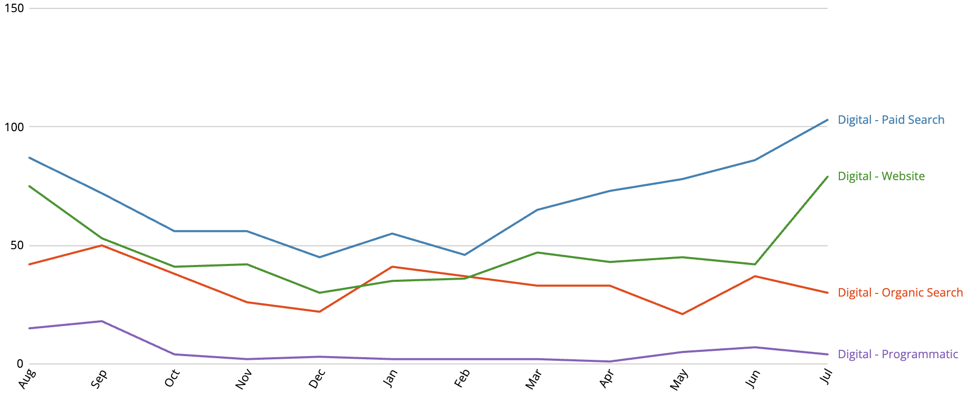
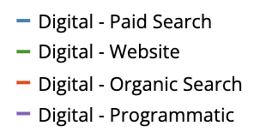
CLF Digitally-driven Sales Activity - Trailing 12 months
Aug 1, 2024 - July 31, 2025
CLF: Digital-only [Paid/SEO] Leads - YTD Comparison
Digital Leads
Phone/Email
Form Leads
Walk-ins
Transactions
Sum of Closed Price
% Total
1865
286
1542
37
67
$91,720,813
48%
YoY 2515 ⬇ 25%
YoY 399 ⬇ 28%
YoY 2074 ⬇ 25%
YoY 39 ⬇ 5%
YoY 73 ⬇ 8%
YoY $75,774,614 ⬆ 21%
36%
Notes:
PBL Sales Activity

Slide 10
YTD Sales Activity
Jan 1 - July 31, 2025
Community | YTD Leads | YTD Closings | YTD Sum of Closed Price | Avg Closed Price / Txn | Lead→Sale Rate | Notes
Palmetto Bluff (PBL) | 819 | 12 | $26,994,000 | $2,249,500 | 1.47% | From July YTD panel. Source: PBL Sales Activity YTD, July report.
Kiawah Island (KIRE) | 682 | 16 | $59,415,170 | $3,713,448 | 2.35% | From July YTD panel. Source: KIRE Sales Activity YTD, July report.
The Cliffs (CLF) | 999 | 16 | $52,258,500 | $3,266,156 | 1.60% | CLF notes 74% of sales from digital YTD. Sources: CLF Sales Activity YTD, July report.
Notes:
PBL Sales Activity

Slide 11
Trend Identification & Discussion
Aug 1, 2024 - July 31, 2025

Slide 12
Some Key Initiatives
July 1 - 31, 2025
PBL Google Ads Account Rebuild
  Started November 1st, 2024
    Complete revamp of strategy
      Budget reallocation
      Location targeting
      Landing pages switched to conversion pages
    Result
      Increase of CTR (account stands around 10%)
      Decrease in CPC
      Conversion quality up after removing micro‑conversions
Kiawah Island Programmatic Ad Testing (StackAdapt)
  Describe StackAdapt & programmatic in general…
    The prospect of more efficient/flexible targeting
    Finer control of strategy & dynamic creative assistance
  Display moved back in late Feb/Mar; responsive display outperforms static assets
Sitelink project launched
  Roughly 65% of all Ad traffic comes through Sitelink clicks
  Sitelinks were reviewed and limited to the strongest CTA’s
Freshfields Meta Ads (Walk-ins)
  Meta Ads targeting Kiawah visitors and focused on driving walk-in traffic to the Freshfields real estate office - Proof of Concept
Notes:
PBL Sales Activity

Slide 13
Trend Identification
Aug 1, 2024 - July 31, 2025
Sales from digital are up
Despite softer lead counts (seen repeatedly in Jan–Apr decks, e.g., SSP YTD pages where closed price outpaced 2024 while leads were flat/down). Example: PBL YTD closed price up while leads were down; CLF also showed closed price strength with fewer leads. Sales cycles are volatile/longer — monthly leads ↔ sales fluctuate; nurturing matters
Paid media inflation & efficiency drift
Paid media inflation; efficiency drift. CPCs up and CTR softening where budgets scaled—e.g., PBL Jan→Jun CPC rose to $2.70 and CTR fell to 8.94% as spend climbed.
Display’s mixed impact
CTR typically drops when display scales, but it can still convert (e.g., KIRE: 60 of ~183 July conversions from display; SAL CTR dropped when display launched—expected).
Organic visibility up; CTR under pressure
Impressions and rankings are trending up while CTR dips as reach widens—PBL (p.7), KIRE (p.17), CLF (p.26). Also, AI Overviews and new SERP features are an opportunity.
Report Needed: impressions, clicks, CTR, avg position by topic/landing page, plus AIO session share.
Fewer leads, bigger deals, sales rebound
Lead and transaction counts are softer, but closed volume is up: PBL YTD closed price +17% with fewer leads/txns (pp.5–6); CLF closed price +53% YTD with leads down and 74% of sales from digital (pp.21–22).
Report Needed: Average sale price by channel and lead→sale conversion.
Notes:
PBL Sales Activity

Slide 14
External Factors to Consider
Revisit PMax. Performance Max campaigns now have better controls (brand exclusions), directional inputs (search themes, page feeds), and reporting—which makes it viable as a complement to Search rather than a black‑box replacement. We would need to use strict guardrails to avoid brand cannibalization and to keep it pointed at community/regime/sub-community and comparison intent.
Top‑of‑funnel is changing. Google is expanding ads inside AI Overviews and AI Mode; we can’t target these explicitly, so the way to “win” is to have high‑quality Search/PMax/Demand Gen that are eligible to surface in those placements.
Housing ad rules still constrain targeting on Google & Meta; we comply (no zip/age/gender in the U.S./CA) and lean on first‑party signals + value‑based bidding.
Meta “Real Estate” vertical: Meta now treats real estate as a separate vertical within their Advantage+ Catalog Ads. This vertical setup means that real estate listings can be promoted at scale without manually crafting each ad—and Meta's system automates matching listings to likely interested audiences.
Notes:
PBL Sales Activity

Slide 15
Competitive Analysis by Project

Slide 16
Competition for Visibility
Portals (Zillow, Realtor.com, etc): On generic “homes for sale” queries, portals often outrank brand sites—defend brand + community exacts with light paid coverage.
Local RE players (Pam Harrington, Justin Winters, etc): Generic and mid‑funnel queries (e.g., “Cliffs at Walnut Cove homes for sale,” “Keowee Springs homes for sale,” “Lake Keowee homes”) are targeted by specialist regional brokerages.
Adjacents (Kiawah Island Resort, Reynolds Lake Oconee, etc): While not competitors in the business sense, these are competitors for visibility for generic and mid-funnel queries
Notes:
PBL Sales Activity

Slide 17
PBL Digital Visibility - Competitive Strategy
Area | Our Position | Who Wins Today | What We Do Next (Priority)
Where we win | Destination‑class brand, on‑property sales, large social reach; robust “Live” hub + search | — | Turn village pages (Moreland, Wilson, River Road, Anson) into Buyer Guides
Where visibility is contested | Head generics (“PB homes”); comparisons vs Sea Pines/Berkeley/Colleton; village discovery | Portals on head terms; nearby clubs on discovery; media on comparisons | Publish “PB vs Sea Pines/Berkeley/Colleton” (neutral, cited) with tables, drive‑times, STR/membership basics
SERP/AIO ownership (now) | Brand visible on brandables; limited rich FAQs on village/comparison; no canonical HTML market report | Third parties own snippets/PAA; portals own carousels | Add FAQPage + Breadcrumb + Article + Org/LocalBusiness schema; ship Quarterly HTML market report (+ PDF)
Competitor set | — | Sea Pines (Resort/RE), Berkeley Hall, Colleton River; portals; aspirational peers (Reynolds) | Interlink guides from “Live” & search; defend brand exacts
Social position | Category‑leading IG (plus Montage) | — | Convert reach: Reels → Guides/Market Report; measure outbound CTR & assisted conversions
Notes:
PBL Sales Activity

Slide 18
KIRE Digital Visibility - Competitive Strategy
Area | Our Position | Who Wins Today | What We Do Next (Priority)
Where we win | Developer authority; deep community inventory; quality content & imagery | — | Codify authority into regime/sub-community Buyer Guides and neutral comparison hubs
Where visibility is contested | Mid‑tail (community/regime/sub-community + “homes”); “Kiawah vs Seabrook/Kiawah River” | Portals on head terms; SIRE, Pam Harrington, Akers Ellis in mid‑tail; Kiawah River on lifestyle | Launch 8–12 regime/sub-community pages (fees/STR/pets/parking) + “Kiawah vs ___” hubs with tables & maps
SERP/AIO ownership (now) | Brand ranks on core brand queries; weak on regime/sub-community/comparison FAQs; few featured FAQs | PAA/snippets often go to brokers/media | Add FAQPage + Breadcrumb + Article + Org/LocalBusiness schema on guides; answer‑first blocks
Competitor set | — | SIRE, Pam Harrington, Akers Ellis, Daniel Ravenel SIR; portals (Zillow/Realtor/Redfin); Kiawah River (adj.) | Build intent‑pure pages that interlink to filtered search; defend with light brand+community exacts
Social position | Leads local brokers on IG; trails “place brands” for lifestyle reach | Kiawah River drives discovery; brokers steady | Run Reels + carousels tied to guides/“vs.” pages; retarget viewers to ownership
Notes:
PBL Sales Activity

Slide 19
CLF Digital Visibility - Competitive Strategy
Area | Our Position | Who Wins Today | What We Do Next (Priority)
Where we win | Multi‑community scale, on‑domain magazine, on‑site brokerage (Cliffs Realty), new amenities (freshness) | — | Convert scale into community Buyer Guides + regime‑level depth (esp. Keowee)
Where visibility is contested | Community queries (Walnut Cove, Keowee Springs/Valley); “Lake Keowee homes” | Portals; specialist brokers (Justin Winter, Walnut Cove Realty), Keowee teams | Ship Walnut Cove Buyer Guide; 5 Keowee regime pages; map‑driven summaries + FAQPage schema
SERP/AIO ownership (now) | Brand shows on brandables; limited FAQ/snippet presence on buyer questions | Brokers/portals/media own PAA/snippets; editorial wins comparisons | Launch “Cliffs vs Old Edwards/Balsam” hubs (neutral, cited); add dated amenity changelogs
Competitor set | — | Old Edwards Reserve, Balsam Mountain Preserve, Walnut Cove Realty, Justin Winter; portals; aspirational: Palmetto Bluff, Reynolds | Buyer‑decision content with bylines, dates, schema; interlink from Communities & New Releases
Social position | Solid vs local peers; trails destination giants | PB/Reynolds command larger audiences shaping expectations | Reels + collabs (lake, Sports Pavilion, “7 clubs, one membership”) → link to guides/new releases
Notes:
PBL Sales Activity

Slide 20
RSM Digital Visibility - Competitive Strategy
Area | Our Position | Who Wins Today | What We Do Next (Priority)
Where we win | Focused inventory/geo; nimble content | — | Concentrate on 2–3 highest‑intent pages; keep funnel tight
Where visibility is contested | Generics and local “homes” queries | Portals; 1–2 local specialists | Launch Buyer Guide(s) + one “vs.” page; exact/phrase NB search; minimal brand defense
SERP/AIO ownership (now) | Sparse structured FAQs; low snippet eligibility | Brokers/media/portals | Add FAQPage schema and answer‑first blocks; bylines + dates
Competitor set | — | Local brokerage leaders; portals; nearest destination peer(s) | Monitor competitors’ pages; replicate winning patterns in owned guides
Social position | Limited audience; can still qualify efficiently | Larger local pages dominate | Run SAC‑compliant Reels/Carousel to guides; remarket; kill what doesn’t convert in 14–21 days
Notes:
PBL Sales Activity

Slide 21
Factors Affecting Digital Visibility
Which are likely to have greatest impact going forward?

Slide 22
What is E-E-A-T?
E-E-A-T is Google’s quality framework for evaluating the trustworthiness and authority of content. It stands for:
Experience – Firsthand knowledge, lived experience, or practical use demonstrated in content.
Expertise – The author’s subject-matter knowledge, credentials, or demonstrable skill.
Authoritativeness – How respected the author/brand/site is in its field (citations, backlinks, mentions).
Trustworthiness – Transparency, accuracy, and reliability of the content and site (e.g., citing sources, secure domains, clear authorship).
Notes:
PBL Sales Activity

Slide 23
Why It’s More Relevant Than Ever
AI Overviews (AIO) & Generative Search
AI summarizers select sources they trust.
Pages demonstrating E-E-A-T signals are more likely to be pulled into AI-generated answers, making trustworthiness a gatekeeper to visibility.
Explosion of AI-generated Content
The web is now flooded with auto-written articles.
Google prioritizes human signals of trust and authority to separate reliable sources from generic AI text.
Shift Toward Entity-based Search
Search engines are connecting people, brands, and organizations as entities.
Strong author bios, LinkedIn profiles, and authoritative mentions reinforce credibility and boost rankings.
Social Media Indexing & UGC Influence
Reddit, TikTok, and LinkedIn posts are being surfaced in SERPs.
Lived experience (the new “E”) gives social posts weight, making authenticity a competitive edge.
YMYL (“Your Money or Your Life”) Content Scrutiny
YMYL pages are those that could impact a person’s health, financial stability, safety, or overall well-being if the information is inaccurate, misleading, or deceptive.
Brands in these areas must demonstrate credentials and accuracy more explicitly than ever.
Notes:
PBL Sales Activity

Slide 24
Digital Visibility is Now a Multi-Signal Ecosystem
AI-driven search results are reshaping visibility (AI Overviews, Microsoft Copilot answers).
Entity authority (brands, people, organizations) is more important than keywords alone.
Content freshness + multimedia (video, social snippets, structured data) increasingly influence discovery.
User engagement signals (dwell time, CTR, shares) feed algorithms beyond classic SEO.
Cross-channel reinforcement (ads, PR, social, influencers) strengthens brand presence in AI-generated summaries.
Notes:
PBL Sales Activity

Slide 25
AI is Re-defining What “Ranking” Means
AI Overviews (AIO): Google summarizes top sources; visibility depends on inclusion in those summaries, not just blue links.
Source selection favors: authority, structured content, freshness, and entity clarity.
Microsoft Copilot/Bing Chat: integrating multiple sources into conversational answers.
Implication: Content must be optimized for answerability (clear, concise, structured) not just SERP rank.
Opportunity: Brands positioned as “trusted sources” get amplified in AI responses.
Notes:
PBL Sales Activity

Slide 26
Social Media Indexing by Google & Microsoft
Google and Bing now surface social posts (Reddit, LinkedIn, TikTok, YouTube Shorts, Instagram).
Community content often outranks brand websites for “real experience” queries.
User-generated content is increasingly indexed and prioritized for “authenticity.”
Implication: Social strategies directly influence search visibility, not just engagement.
Action: Optimize posts for discovery — keywords in captions, alt text, hashtags, and ensure brand voice is consistent across platforms.
Notes:
PBL Sales Activity

Slide 27
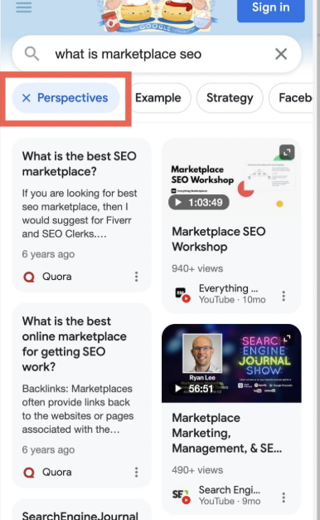
Social Media Strategy Changes
Social Media is becoming more integrated with search:
Google crawls social media platforms, treating them like websites, to find and index content based on keywords, themes, and user intent.
When a user searches for something, Google may display relevant social media content alongside traditional website results.
Google has introduced a "Perspectives" filter in search results, which can include social media content, especially for queries where users are looking for personal experiences and opinions.
While Google doesn't explicitly state that social signals are a direct ranking factor, social media engagement can indirectly influence SEO performance by indicating content relevance and driving traffic.
Notes:
PBL Sales Activity

Slide 28
Social Media Competitor Snapshots
Brand/competitor social snapshots (approx., platform‑reported today):
KIRE: IG ≈14K; FB ≈5.7K likes. InstagramFacebook
Akers Ellis: IG ≈6.2K; FB ≈4.2K followers / 3.8K likes. InstagramFacebook
Pam Harrington: IG ≈1.9K; FB ≈17K followers. InstagramFacebook
Daniel Ravenel SIR: IG ≈6.6K. Instagram
The Cliffs: IG ≈11K; FB ≈8.7K followers. InstagramFacebook
Old Edwards Reserve at Lake Keowee: IG ≈7K; (rebrand confirmed). InstagramThe Reserve at Lake Keowee
Balsam Mountain Preserve: IG ≈4.1K; FB ≈5.5K followers. InstagramFacebook
Justin Winter & Associates (FGP): IG ≈2.3K. Instagram
Palmetto Bluff: IG ≈56K; FB ≈34K followers.
Sea Pines Resort: IG ≈37K; FB ≈130K followers.
Berkeley Hall Club: IG ≈2.8K; FB ≈3.2K followers. Facebook
Colleton River Club: IG ≈3.1K; FB ≈7.6K followers (7.2K likes).
Notes:
PBL Sales Activity

Slide 29
Digital Strategy Recommendations
What does all this mean for Digital Strategy going forward?

Slide 30
Paid Media Strategy Recommendations - Channels
Search – Brand Defense: Minimal, monitored (2–3%).
Search – Non‑Brand: High‑intent themes (regime/sub-community, village, “vs.” comparisons).
PMax (guard‑railed): Asset groups mapped to community/regime/sub-community/village URL sets using page feeds, steered by search themes, with brand exclusions on.
Demand Gen (replaced Discovery) + YouTube: Mid‑funnel creation with Shorts/in‑feed + lead optimizations—new 2025 controls make this practical to scale.
Display: Retargeting (golf, luxury travel, WSJ/Bloomberg‑type inventory)
Paid Social (Meta): Run under Special Ad Category—Housing with Advantage+ placements, broad location radius, creative that pre‑qualifies, and CRM‑powered remarketing (no lookalikes).
Microsoft Advertising (pilot): 5–10% of non‑brand Search to capture incremental demand and ads showing in Copilot experiences.
We can hold an additional 40% contingency per project and release it in waves when CPA/lead‑quality and Search Impression Share (lost to rank) show headroom
Notes:
PBL Sales Activity

Slide 31
PBL (Palmetto Bluff) — $264,000 baseline - Contingency ($105,600)
Search NB: “Moreland/Wilson/River Road/Anson homes”, “PB vs Sea Pines/Berkeley/Colleton,” “STR rules,” “membership basics.”
PMax: Asset groups per village Buyer Guide + comparisons; page feeds limit to those URLs; search themes echo key questions; value‑based bidding to tours.
Demand Gen/YouTube: Lifestyle storytelling in Shorts + in‑feed; 2025 controls allow channel/placement curation (e.g., Shorts‑first).
Paid Social: PB + Montage collabs to Buyer Guides & Market Report; server‑side leads; SAC rules.
(This mirrors the high‑reach social → guide conversion loop we’ve proven on similar hospitality/real‑estate work.)
Channel | % | Annual Target
Brand | 2% | $5,280
Non‑Brand | 28% | $73,920
PMax | 22% | $58,080
Demand Gen / YouTube | 22% | $58,080
Display | 10% | $26,400
Paid Social | 14% | $36,960
Experiments (MSFT, etc) | 2% | $5,280
Notes:
PBL Sales Activity

Slide 32
KWH (Kiawah) — $185,000 baseline - Contingency ($74,000)
Search NB: exact/phrase for regime/sub-community fees / STR rules / pets / parking and “Kiawah vs Seabrook/Kiawah River.”
PMax: Asset groups: Ocean Park, Cassique, East/West Beach, Vanderhorst; page feed with those Buyer Guide URLs; brand exclusions; search themes = the above queries.
Demand Gen/YouTube: Reels‑style vertical video (“Which community fits me?”); Shorts‑only splits available in 2025 updates.
Display: Retargeting (guide readers, comparison readers) with FAQ snippets in creatives.
Paid Social: SAC‑compliant Reels to Buyer Guides; test Instant Forms for tour/appointment; CRM pass‑back to Ads.
Channel | % | Annual Target
Search – Brand | 3% | $5,550
Search – Non‑Brand | 35% | $64,750
PMax (guard‑railed) | 18% | $33,300
Demand Gen / YouTube | 17% | $31,450
Display (retargeting/prospecting) | 10% | $18,500
Paid Social (Meta) | 15% | $27,750
Experiments (MSFT Ads, social, etc) | 2% | $3,700
Notes:
PBL Sales Activity

Slide 33
CLF (The Cliffs) — $166,500 baseline - Contingency ($66,600)
Search NB: “Cliffs at Walnut Cove homes”, “Keowee Springs homes”, “Cliffs Valley homes,” “best golf communities Asheville/Greenville”.
PMax: Asset groups: Walnut Cove, Keowee Springs, Valley, Membership, plus “Cliffs vs Old Edwards/Balsam” comparisons; page feed locked to guides; value‑based bidding (tour set > brochure download).
Demand Gen/YouTube: Sequences featuring Sports Pavilion, “7 clubs, one membership,” and lake lifestyle; retarget to New Releases.
Paid Social: Reels + carousels; “Which Cliffs community fits me?” quiz ad.
(Competitor context: Walnut Cove Realty & Keowee specialists appear on priority queries—hence the focus on community guides.)
Channel | % | Annual Target
Brand | 2% | $3,330
Non‑Brand | 32% | $53,280
PMax | 20% | $33,300
Demand Gen / YouTube | 18% | $29,970
Display | 10% | $16,650
Paid Social | 16% | $26,640
Experiments | 2% | $3,330
Notes:
PBL Sales Activity

Slide 34
RSM — $36,000 baseline - Contingency ($14,400)
Channel | % | Annual Target
Brand | 3% | $1,080
Non‑Brand | 45% | $16,200
PMax | 15% | $5,400
Demand Gen / YouTube | 10% | $3,600
Display | 7% | $2,520
Paid Social | 15% | $5,400
Experiments | 5% | $1,800
Search NB first (+ brand defense); PMax page‑feed pilot on the two highest‑value pages; remarketing only on Display & Social until CPA stabilizes.
Hold top‑of‑funnel until unit‑level inventory or a defensible “vs.” page exists.
Notes:
PBL Sales Activity

Slide 35
Positioning for AI-Driven & Multi-Signal Search
Optimize for AI Overviews (AIO):
Structure content for answerability (clear Q&A, schema markup, concise summaries).
Prioritize freshness and authority signals to increase likelihood of inclusion.
Strengthen EEAT:
Showcase author credentials and lived experience.
Publish transparent, sourced, and accurate content.
Target Entity Authority:
Ensure consistent brand/person profiles across web, LinkedIn, press.
Use structured data to reinforce entity recognition.
Broaden Signal Mix:
Integrate video, imagery, and user-generated content to capture diverse ranking factors.
Notes:
PBL Sales Activity

Slide 36
Leveraging Social Indexing & Navigating YMYL Standards
Social Visibility Optimization:
Treat social posts as SEO assets — use clear keywords, captions, and hashtags.
Encourage user-generated reviews/testimonials to boost authenticity signals.
Mitigate Inventory Filter Risks (Meta):
Manually set brand-safe inventory filters (Moderate/Limited vs Expanded).
YMYL Scrutiny Response:
For real estate compliance: highlight expertise and cite reputable sources.
Include author bios, credentials, and transparent sourcing on all high-stakes content.
Cross-Channel Reinforcement:
Use PR, ads, and influencer engagement to strengthen trust and authority across search + social ecosystems.
Notes:
PBL Sales Activity

Slide 37
Thank You

