Slide 1


Polymershapes Monthly Ads Overview
Examining: Oct 1-20, 2024

Slide 2
MoM Account Metrics
September 1-20, 2024
Impressions: 140,977
Clicks: 11,908
CTR: 8.45%
Avg CPC: $3.41
Conversions: 1,503.24
October 1-20, 2024
Impressions: 191,509
Clicks: 11,199
CTR: 5.85%
Avg CPC: $3.40
Conversions: 1,328.31
So far in October, the ads reached a significantly larger audience compared to September, demonstrating increased visibility and exposure. Despite a slight drop in conversions, the cost per click remained consistent. With this broader reach, there’s an opportunity to fine-tune targeting or messaging to better connect with the expanded audience and drive more conversions. The steady CPC ensures that even with adjustments, the campaign can maintain cost-effectiveness while optimizing performance.

Slide 3
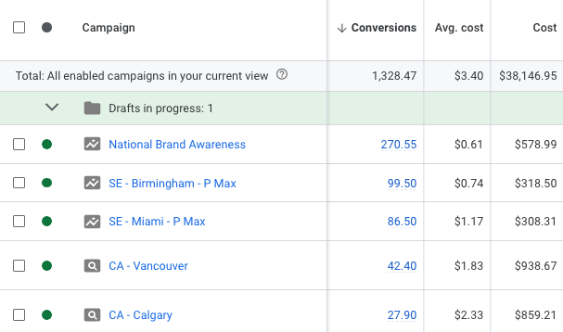
Top Performing Profit Centers
Highest MoM increase in conversions:
SE - Miami - PMax: +24.5 (+39.52%) conversions
NE - Baltimore - Secondary: +10 (+142.69%) conversions
NE - Toledo - Secondary: +9.83 (+393.33%) conversions
Highest MoM increase in clicks:
WE - San Diego - Primary: +27 (+40.3%) clicks
WE - Birmingham - PMax: +24 (+5.88%) clicks
SE - Largo - Secondary: +23 (+29.87%) clicks
Takeaways:
Profit centers with highest flat increases MoM were scattered in terms of regions- there were no notable increases in one region compared to another.
When examining the flat conversions numbers, performance max campaigns performed the best. They spent less than search campaigns, had much lower CPCs and converted at significantly higher rates. We will need to verify the legitimacy of these conversions, but provided they are real leads it will be beneficial to incorporate performance max alongside search campaigns in order to decrease CPC, increase leads and maximize efficiency.
Highest Flat Conversions Oct 1-20

Slide 4
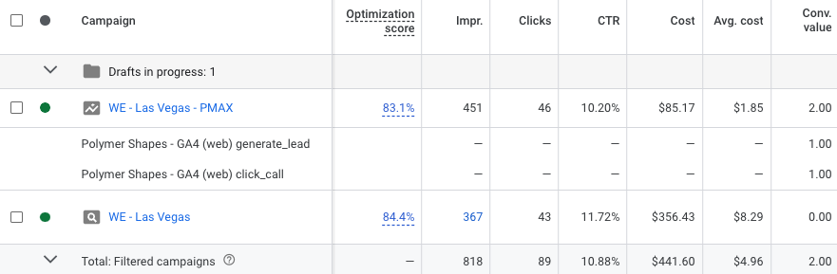
WE - Las Vegas
One of the key challenges we've faced in Las Vegas over the past few months has been the high CPC. However, after implementing a Performance Max (Pmax) campaign, the average CPC dropped from $8.29 to $4.96, split between regular search and Pmax. Notably, the Pmax campaign delivered two conversions, while the standard search had none over a 20-day period. For profit centers with higher CPCs, transitioning to a Pmax campaign could be a beneficial strategy.
Pros: More efficient use of spend, with broader reach across multiple channels.
Cons: Less control over ad placements and limitations in targeting specific materials.
Current URL for Las Vegas PMax campaign: https://www.polymershapes.com/locations/las-vegas/

Slide 5
Top Performing Materials
Whole account CPC average: $3.40
Among the top 30 material ad groups that generated conversions:
(9) Building and Construction: Avg CPC - $3.21
(8) Fabrication: Avg CPC - $4.11
(5) Acrylic: Avg CPC - $3.44
(5) Plastics: Avg CPC - $3.77
Takeaways: The account-wide CPC for October 1-20 was $3.40. Since these material ad groups are driving frequent conversions, lowering their CPC would help optimize the budget and increase clicks and conversions. The goal is to bring the CPC for these popular material groups below the overall account CPC.

Slide 6
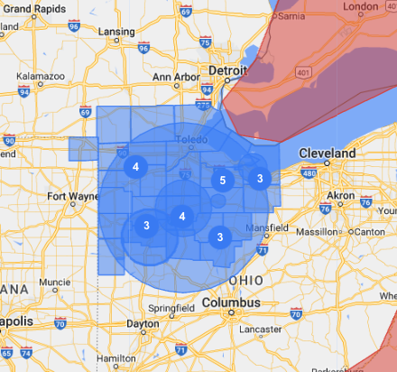
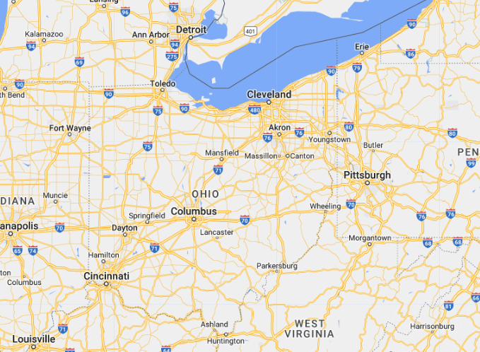
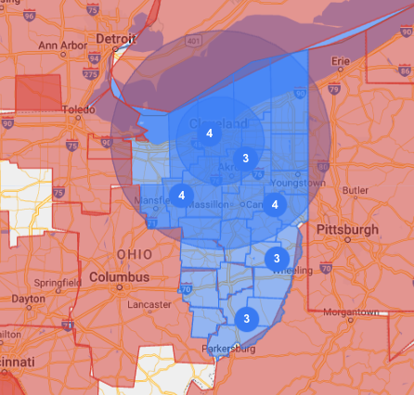
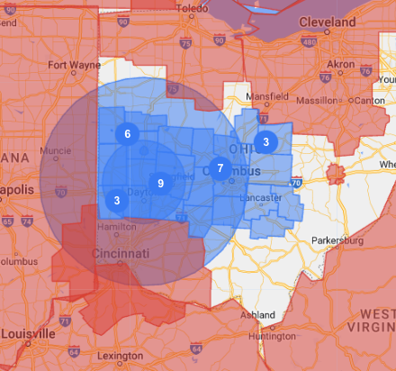
Ohio Locations (Overview)
Toledo
Cleveland
Dayton

Slide 7

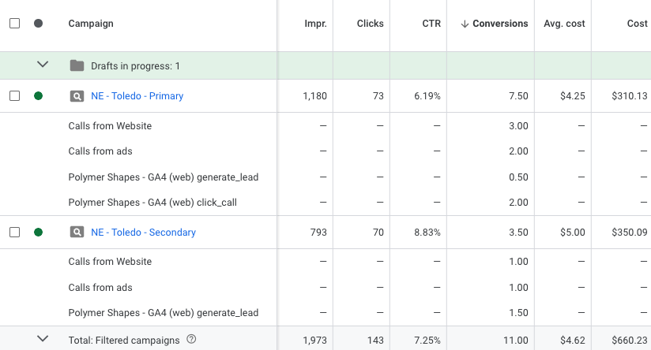
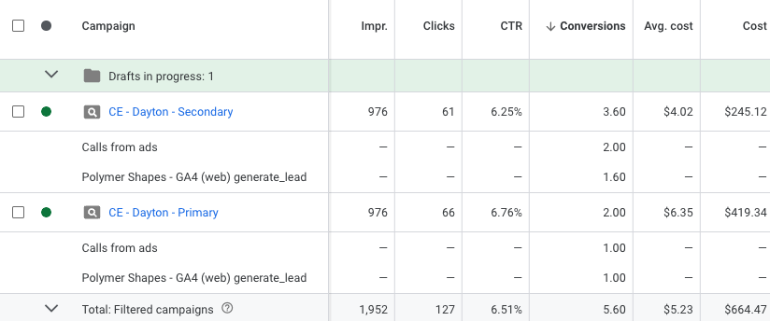

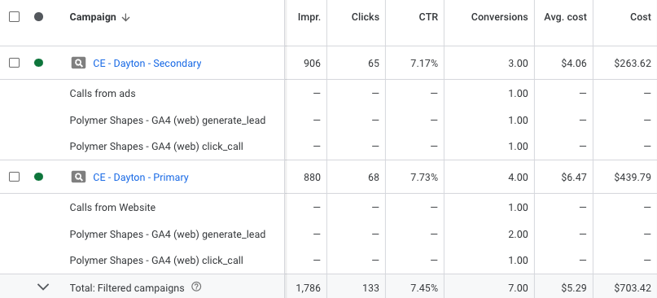
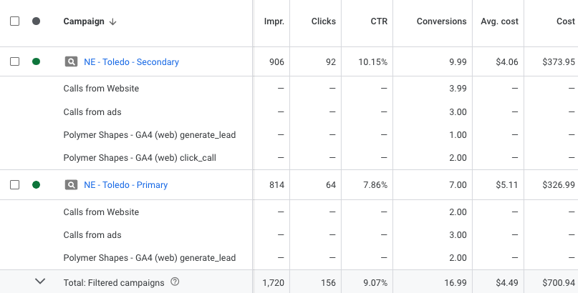
Ohio Locations
Toledo
Dayton

Slide 8
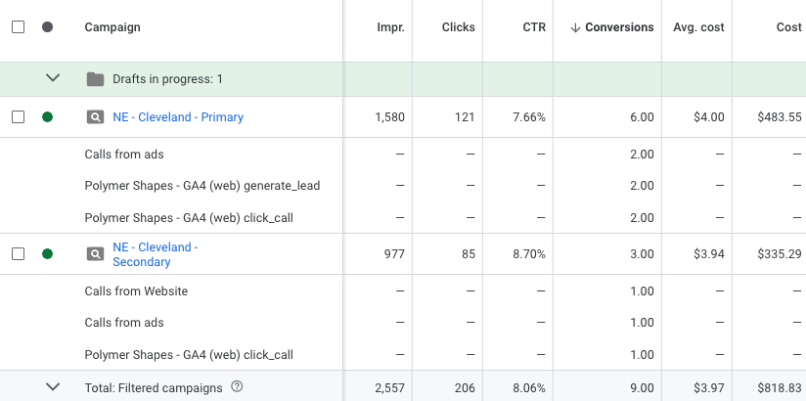
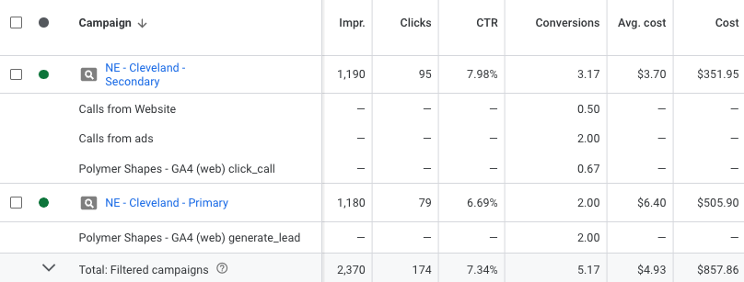
Ohio Locations
Cleveland
Ohio’s locations are fairly evenly spread across profit centers (Dayton, Toledo, Cleveland). However, the radius settings currently exclude certain areas within the radius, which may be limiting extra traffic. Removing these exclusions could increase traffic from nearby locations within the radius. However, in terms of MoM traffic, the only location with notable decrease in conversions is Toledo. Location targeting wouldn’t be the main issue when examining campaign performance. We can take a look at budget reallocation between the primary/secondary campaigns

Slide 9
Action Items/Takeaways
Potential addition of Performance Max Campaigns
  Find a campaign with high CPC
  Requires a location specific page
Seattle Budgets - Primary vs Secondary
  From last week’s call - do we want to increase the primary campaign’s budget in favor of secondary because of the conversion drop?
Ad strength for Fabrication/Plastics to lower CPC
  Since fabrication and plastics were among top converting ad groups, increasing ad strength will help improve click through rates and lower CPC
Remove nearby surrounding negated areas for Ohio campaigns

