Slide 1
Polestar Charlotte
December 2024

Slide 2
Paid Performance

Slide 3
Google Ads: MoM Performance
Paid Performance
Month | Impr. | Clicks | CTR | Cost | Avg. CPC | Search Impr. Share
November 2024 | 1,696,341 | 16,716 | 0.99% | $11,656.49 | $0.70 | <10%
December 2024 | 1,331,522 | 11,383 | 0.85% | $11,660.30 | $1.02 | <10%
December 2024 performance metrics reflect a mixed outcome compared to November 2024. Impressions and clicks decreased, leading to a slight decline in CTR, while the average CPC rose from $0.70 to $1.02, indicating higher competition or shifts in bidding dynamics. The relation between the decrease in impressions and clicks show a downward trend in December.

Slide 4
Paid Performance
Google Ad Keywords: Monthly Performance
Top 5 keywords that brought in most clicks:
“Polestar”
“Polestar auto”
“Polestar 3”
“Tesla”
“Lucid car”
Summary: Branded search term “Polestar” brought in the most clicks, followed by “Polestar auto”.
The top three keywords driving clicks all included the branded term “Polestar.” These keywords achieved impressive CTRs of approximately 30%, supported by strong top-of-page impression shares. Within this group, impression share ranged from 67% to 90%, with an average absolute top impression share of around 80%. These metrics highlight the high relevance of our ads, as recognized by Google, resulting in consistent placement in top positions.

Slide 5
Paid Performance
Google Ads Structure: Active Campaigns
Active Campaigns (December 2024)
YouTube - Polestar Brand Awareness
Polestar 3
General
Display
Conquest

Slide 6
Paid Performance
Google Ads Key Takeaways
Summary: December saw a slight decline in performance metrics
December Key Takeaways:
Overall, the account experienced a decline in performance metrics, with both impressions and clicks decreasing in December compared to November. The rise in CPC contributed modestly to this downturn
Our keywords and ads demonstrated strong effectiveness in terms of impression share. The top three keywords achieved exceptionally high impression share and absolute top-of-page rates, indicating that our ads were highly relevant and consistently ranked above competitors by Google
In the future, optimizations around specific audience targeting as well as keywords optimizations will be done in order to maximize effectiveness

Slide 7
Paid Performance
Facebook Structural Overhaul (MoM)
Active Campaigns (December 2024)
Traffic | Polestar 3| Ongoing
Active Campaigns (November 2024)
Traffic | Polestar 3| Ongoing
The campaign are using prospecting, service, and sold lists from ELeads, broad targeting, and detailed targeting from University Volvo. Additionally, the campaign is using the ongoing lease list.
Ad creative was the same as as last month, reflecting the lease price of $599. Due to the Polestar ad program, the ads ended on December 20th.

Slide 8
Paid Performance
Facebook Structural Overhaul (MoM)
December (2024)
Impressions: 194,998
Cost: $4,885.77
Clicks: 4,760
CPC: $1.03 CTR: 2.44%
Δ%
-0.41%
+3.50%
-16.42%
+24.09% +52.50%
November (2024)
Impressions: 335,444
Cost: $4,720.76
Clicks: 5,695
CPC: $0.83 CTR: 1.60%
Takeaways:
November and December are the most expensive months of the year for running social advertisements. There was a 72.71% increase in budget between November and December in order to maintain the visibility of Polestar Charlotte in this medium. Significantly fewer impressions were received, but clicks and CTR were still very strong metrics.

Slide 9
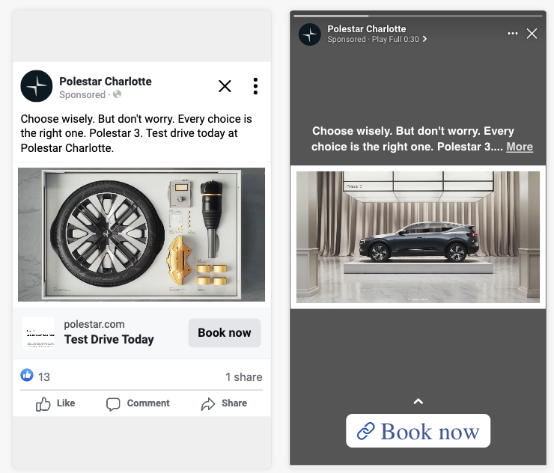
Paid Performance
Facebook Structural Overhaul YoY Performance (Cont.)
November and December 2024
The video create we are currently using covers all major Meta ad placements (Feed, Story, and Reels) for both Facebook and Instagram.
Each of the creative assets provided enabled these ads to fit every possible placement Meta offers for advertising.
Holiday Polestar 3 creative was used for December as it was provided by the creative team.

