Slide 1


Polymershapes Monthly Ads Overview
August 2025
(August 1 - 25)

Slide 2
MoM Account Metric Comparison
July 1 - 25, 2025
Impressions: 204,158
Clicks: 15,365
CTR: 7.53%
Avg CPC: $3.73
Conversions: 961.04
Active Campaigns: 114
Cost: $57,301.43
August 1 - 25, 2025
Impressions: 201,013
Clicks: 14,355
CTR: 7.14%
Avg CPC: $3.53
Conversions: 1,000.64
Active Campaigns: 117
Cost: $50,741.61
The account experienced several notable month-over-month shifts. Impressions and clicks remained relatively stable, while CTR declined slightly, though not at a significant level. Average CPC decreased, indicating a positive trend compared to prior periods. Total cost also fell significantly and on top of that conversions in August exceeded those in July. This shows that despite lower spend, the account is trending in the right direction as anticipated.

Slide 3
YoY Account Metric Comparison
August 1 - 25, 2024
Impressions: 216,275
Clicks: 13,928
CTR: 6.44%
Avg CPC: $3.32
Conversions: 1,315.55
Active Campaigns: 84
Cost: $46,187.71
August 1 - 25, 2025
Impressions: 201,013
Clicks: 14,355
CTR: 7.14%
Avg CPC: $3.53
Conversions: 1,000.64
Active Campaigns: 117
Cost: $50,741.61
August 2024 metrics are very similar to 2025. Impressions, clicks, and CTR remained steady YoY. Average CPC saw a small increase, but nothing significant for a yearly time period. Conversions saw a notable decrease, but we turned off duplicate phone call conversions late last year, which could contribute to the decrease.
Overall, YoY metrics remain steady and with continued updates the account is well-positioned to maintain and improve results moving forward.

Slide 4
Top Performing Ad Groups
August 2025
Ongoing Ad Strength project:
Building and Construction
Fabrication
Acrylic
Plastics
HDPE
Polycarbonate
UHMW
Nylon
Acetal
Duct Bank Spacers*
Next ad group: Aisle Containment

Slide 5
Campaign Updates
August 2025
Indianapolis
  Primary: $25/day
    Plastics, Fabrication, Acrylic, B&C
  Secondary: $24/day
    UHMW, Acetal, Thermoforming
  Tertiary: $20/day (Newly created)
    HDPE (moved from Primary)
Providence
  Paused Plastics + Engineering plastics, Foamboard
  Primary: $19/day
    Nylon, Acetal, PTFE
  Secondary: $10/day (Newly created)
    B&C
Syracuse
  Paused Acetal, UHMW
  Added Plastics + Engineering Plastics

Slide 6
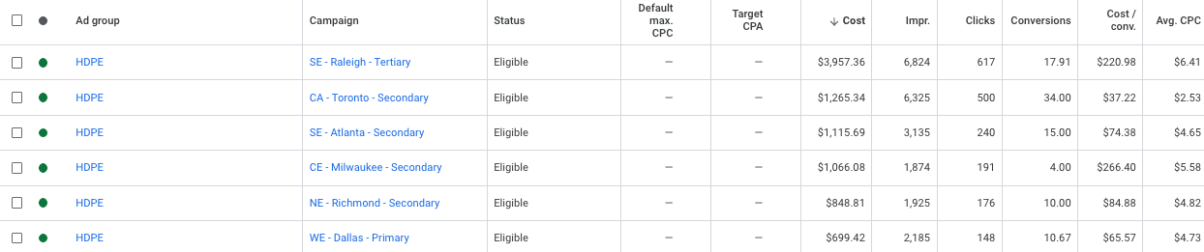
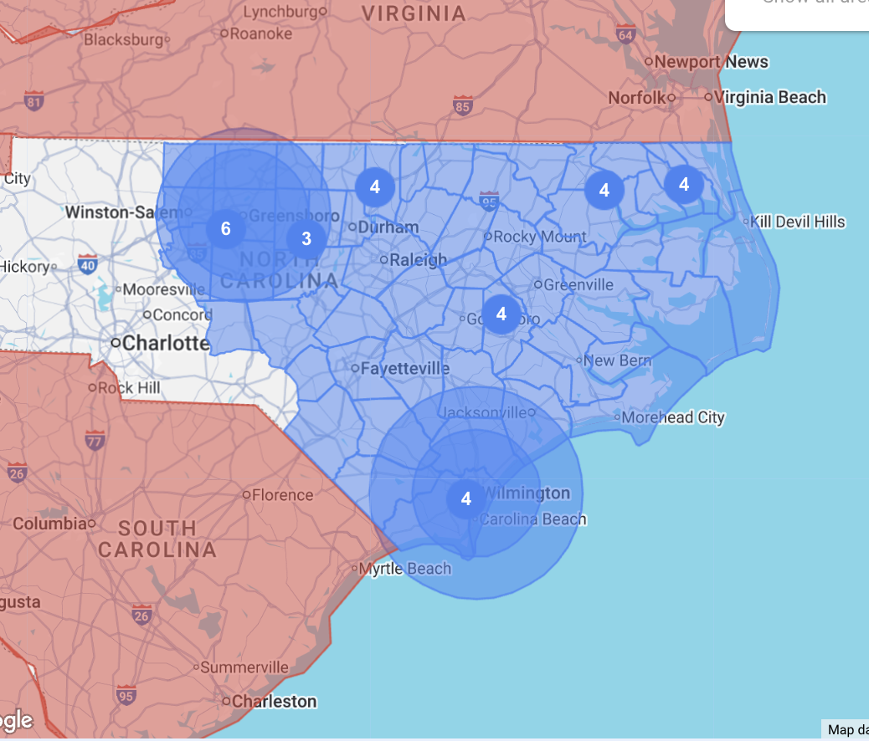
Raleigh - HDPE Ad Group Comparison
Raleigh Ads Location Targeting
August 2025
When comparing the HDPE ad group in Raleigh to identical ad groups in other markets, performance metrics show notable differences. Most significantly, Raleigh’s average CPC was substantially higher than the overall account average, which influenced other results. Despite driving the highest number of clicks among all HDPE ad groups, the elevated CPC impacted efficiency. Raleigh also generated more conversions in total; however, its cost per conversion was considerably higher than the account total. This suggests heightened competition for HDPE in Raleigh compared to other regions. As a result, HDPE may not be the most cost-effective material to prioritize for leads or sales. While the increased budget did help generate additional traffic and conversions, other materials may present stronger ROI opportunities.

Slide 7
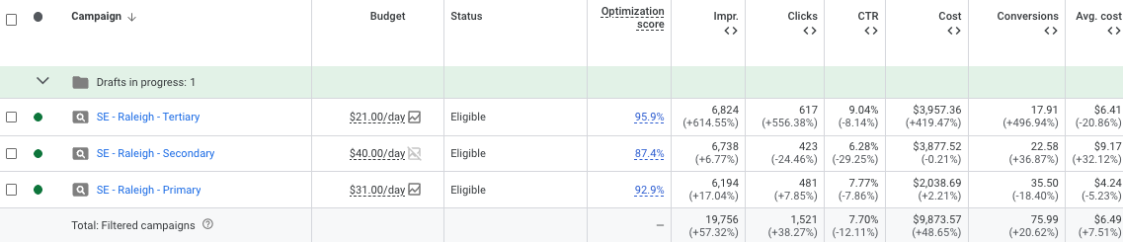

Raleigh - Campaign Performance
August 2025
When evaluating the Raleigh campaigns as a whole, performance shows consistent improvement across key metrics. Conversions increased notably across all three campaigns, with impressions rising by over 50%. Click volume also grew significantly in line with the increased spend. While CTR declined across the campaigns, this was anticipated due to the substantial rise in impressions; despite this, the combined CTR across these campaigns remains strong at 7.70%, well above the industry benchmark of around 3–4%.
Overall, the additional investment yielded positive results for the Raleigh-specific campaigns. However, a review of HDPE ad groups across the account suggests that allocating resources to other material ad groups could potentially drive stronger performance and a better return on spend.

Slide 8
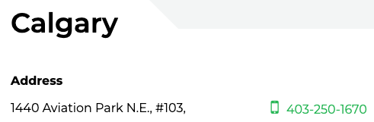
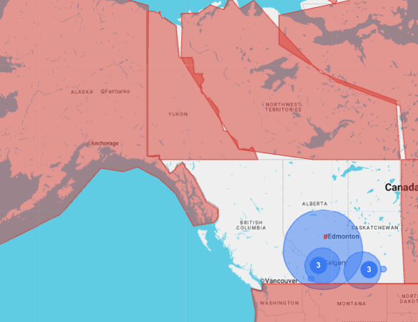
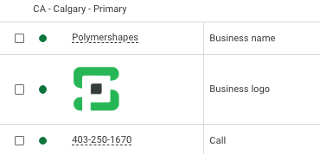
Calgary
August 2025
Calgary- getting calls from Alaska?
Odd issue – we have been fielding a regular amount of calls from customers looking for PS in Alaska- 2 just today.
One of our ISRs said he Googled PS Alaska, and PS Calgary pops up on the side of the search. ?
CK note – it looks like a GMB listing popping up? Vancouver location DOES target Alaska.
Calgary Ads Targeting:
Campaign level phone number matches number on website and GMB

Slide 9
Phone Call Issues
August 2025
Campaigns with no phone calls (all time)
CE – Detroit – Primary - (248) 616-0300 (Added phone call asset to campaign level from GMB)
CE – Detroit – Secondary - (248) 616-0300
CE – Detroit - Tertiary - (248) 616-0300
WE – Las Vegas – PMAX - (702) 732-8866
WE – Austin – Duct Bank Spacers - (512) 687-0771
SE – Charleston - Primary - (843) 614-6715
SE – Charleston – Secondary - (843) 614-6715
CE – Cedar Rapids - (319) 365-1460
SE – Lexington – Secondary - (859) 742-6690 (Already in account) newly created (July 14)
NE – Pittsburgh – Tertiary - (724) 775-9205 (Already in account) newly created (July 16)
CE – Milwaukee – Tertiary - (262) 251-1200 (Already in account) newly created (July 24)
SE – Orlando – Tertiary - (407) 851-0624 (Already in account) newly created (August 14)
Low call volume:
WE – Seattle – Secondary - (206) 575-1462
WE – Austin – Thermoforming - (512) 687-0771 (Already in account) newly created (July 2)
NE – Toledo – Tertiary - (419) 482-0962 (Already in account)
CE – Dayton – Secondary - (937) 877-1903 (Already in account) newly created (July 2)
SE – Columbia/Greenville – Secondary - (803) 254-0550 (Already in account) newly created (July 8)
NE – Philadelphia - Tertiary - (215) 638-9460 (Already in account)

Slide 10
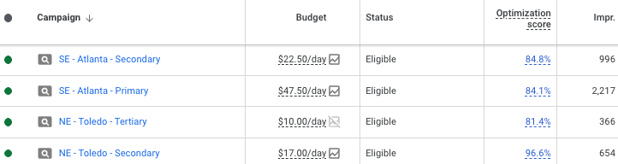
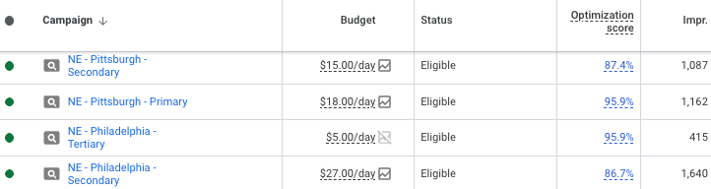
Phone Call Issues
August 2025
NE – Toledo – Tertiary
NE – Philadelphia - Tertiary

Slide 11
Toronto
August 2025
UPDATE: Mock-up has been created and sent to Courtney & team. Currently awaiting approval. Team needs to discuss whether we need the competitor page BEFORE or AFTER new site goes live.
Piedmont- competitor with large market share
Suggestions:
  We could make a separate campaign, rather than an ad group
  Depending on the budget, we can target specific materials or just a general competitor page
    If we want to target specific materials (ex: Acrylic/Polycarbonate), specific pages can be created referring to (competitor) - “Polymershapes - Acrylic” or “Polymershapes - Polycarbonate”
      If we go this route, this landing page can only be used for one competitor (Piedmont)
    We can also create a “General competitor” landing page with messaging like “What makes Polymershapes Different” or “A Better Alternative to Plastics”
      Incorporate generalized copy to use for any competitor if other profit centers are experiencing similar issues
  (After landing page is created) Ad copy will also be tailored to fit competitor messaging

Slide 12
Action Items/Takeaways
August 2025
Improvement of Aisle Containment ad strength
Toronto competitor campaign for Piedmont
  Create landing page ←
  Create ads campaign
  Optimizations
Budget sheet- awaiting Polymershapes team for confirmation
Continued campaign updates

